Slide 1
信息学中的概率统计
王若松
前沿计算研究中心
北京大学

Slide 2
多维连续随机变量
多维连续随机变量的分布函数和密度函数
多维连续随机变量的独立性
多维连续随机变量的特征数
多维连续随机变量函数的分布
多维高斯分布

Slide 3
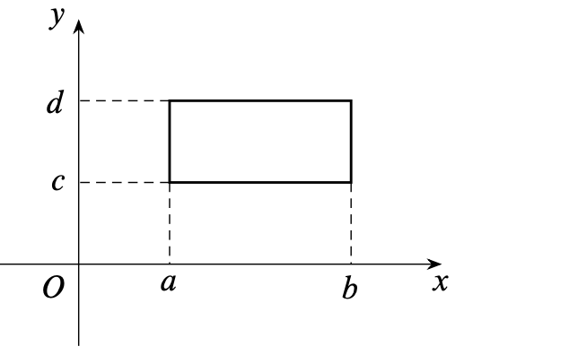
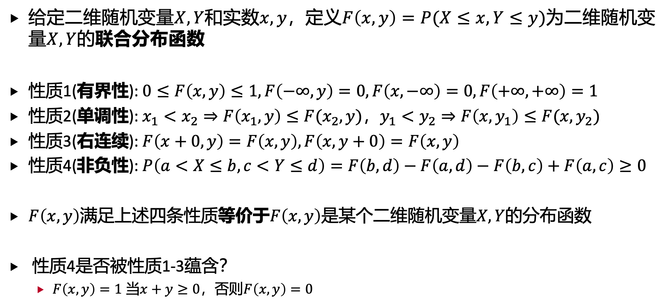
1. 多维连续随机变量的分布函数和密度函数
给定二维随机变量$X,Y$和实数$x,y$，定义$F\left(x,y\right)=P(X≤x,Y≤y)$为二维随机变量$X,Y$的联合分布函数
性质1(有界性): $0≤F\left(x,y\right)≤1,F\left(−∞,y\right)=0,F\left(x,−∞\right)=0,F\left(+∞,+∞\right)=1$
性质2(单调性): $x_{1}<x_{2}⇒F\left(x_{1},y\right)≤F(x_{2},y)$，$y_{1}<y_{2}⇒F\left(x,y_{1}\right)≤F(x,y_{2})$
性质3(右连续): $F\left(x+0,y\right)=F\left(x,y\right),F\left(x,y+0\right)=F\left(x,y\right)$
性质4(非负性): $P\left(a<X≤b,c<Y≤d\right)=F\left(b,d\right)−F\left(a,d\right)−F\left(b,c\right)+F\left(a,c\right)≥0$
$F\left(x,y\right)$满足上述四条性质等价于$F\left(x,y\right)$是某个二维随机变量$X,Y$的分布函数
性质4是否被性质1-3蕴含？
$F\left(x,y\right)=1$ 当$x+y≥0$，否则$F\left(x,y\right)=0$

Slide 4
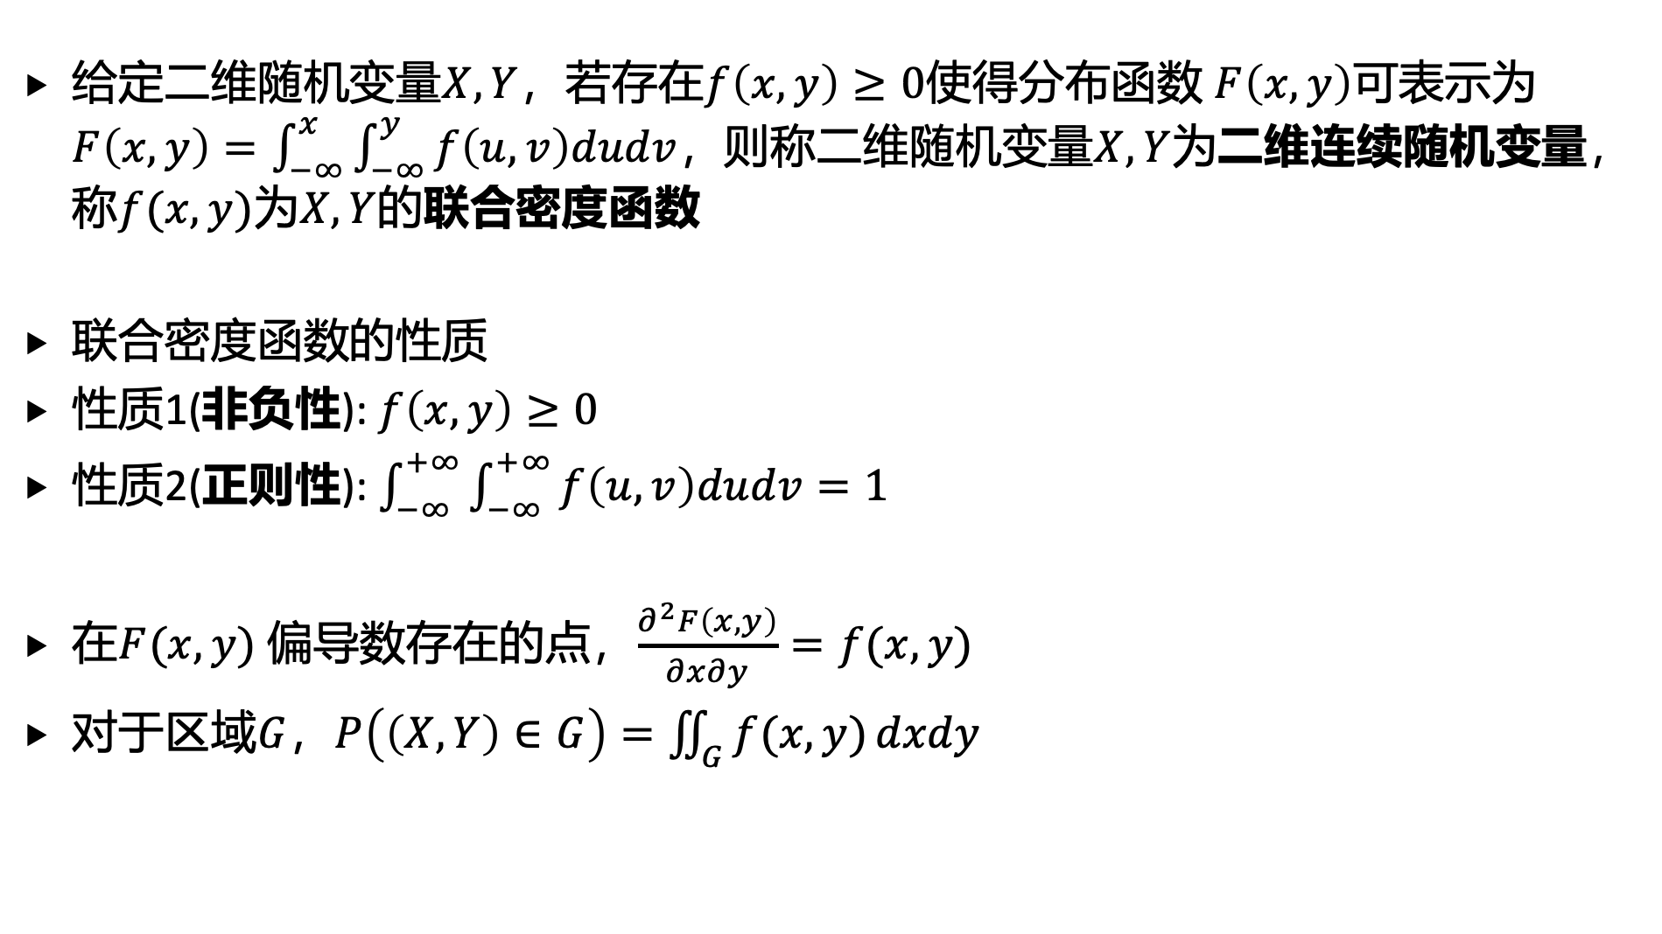
1. 多维连续随机变量的分布函数和密度函数
给定二维随机变量$X,Y$，若存在$f\left(x,y\right)≥0$使得分布函数 $F\left(x,y\right)$可表示为 $F\left(x,y\right)=\int_{−∞}^{x}{\int_{−∞}^{y}{f\left(u,v\right)dudv}}$，则称二维随机变量$X,Y$为二维连续随机变量，称$f(x,y)$为$X,Y$的联合密度函数
联合密度函数的性质
性质1(非负性): $f\left(x,y\right)≥0$
性质2(正则性): $\int_{−∞}^{+∞}{\int_{−∞}^{+∞}{f\left(u,v\right)dudv}}=1$
在$F(x,y)$ 偏导数存在的点，$\frac{∂^{2}F\left(x,y\right)}{∂x∂y}=f(x,y)$
对于区域$G$，$P\left(\left(X,Y\right)∈G\right)=\iint_{G}{f(x,y)}dxdy$

Slide 5
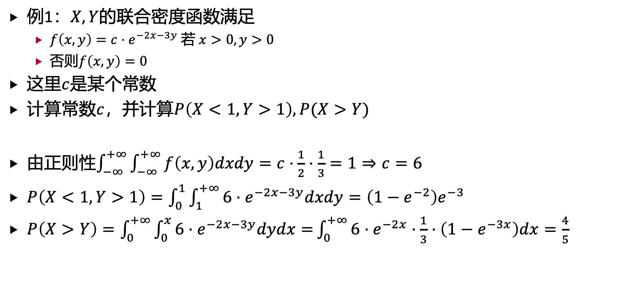
1. 多维连续随机变量的分布函数和密度函数
例1：$X,Y$的联合密度函数满足
$f\left(x,y\right)=c⋅e^{−2x−3y}$ 若 $x>0,y>0$
否则$f\left(x,y\right)=0$
这里$c$是某个常数
计算常数$c$，并计算$P\left(X<1,Y>1\right), P(X>Y)$
由正则性$\int_{−∞}^{+∞}{\int_{−∞}^{+∞}{f\left(x,y\right)dxdy}}=c⋅\frac{1}{2}⋅\frac{1}{3}=1⇒c=6$
$P\left(X<1,Y>1\right)=\int_{0}^{1}{\int_{1}^{+∞}{6⋅e^{−2x−3y}dxdy=\left(1−e^{−2}\right)e^{−3}}}$
$P\left(X>Y\right)=\int_{0}^{+∞}{\int_{0}^{x}{6⋅e^{−2x−3y}dydx=}}\int_{0}^{+∞}{6⋅e^{−2x}⋅\frac{1}{3}⋅\left(1−e^{−3x}\right)dx=\frac{4}{5}}$

Slide 6
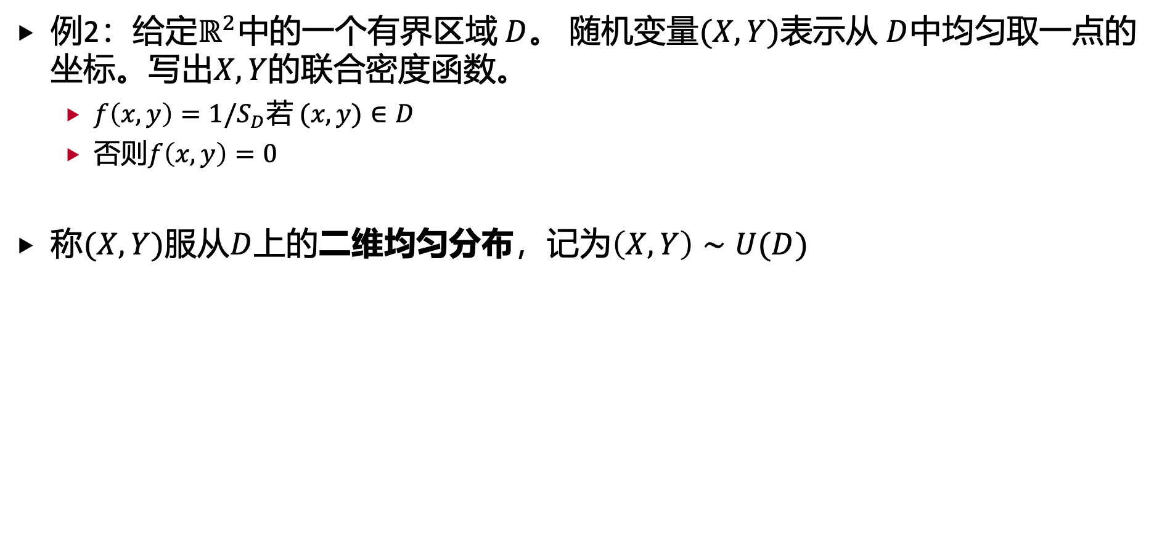
1. 多维连续随机变量的分布函数和密度函数
例2：给定$ℝ^{2}$中的一个有界区域 $D$。 随机变量$(X,Y)$表示从 $D$中均匀取一点的坐标。写出$X,Y$的联合密度函数。
$f\left(x,y\right)=1/S_{D}$若 $(x,y)∈D$
否则$f\left(x,y\right)=0$
称$(X,Y)$服从$D$上的二维均匀分布，记为$\left(X,Y\right)∼U(D)$

Slide 7
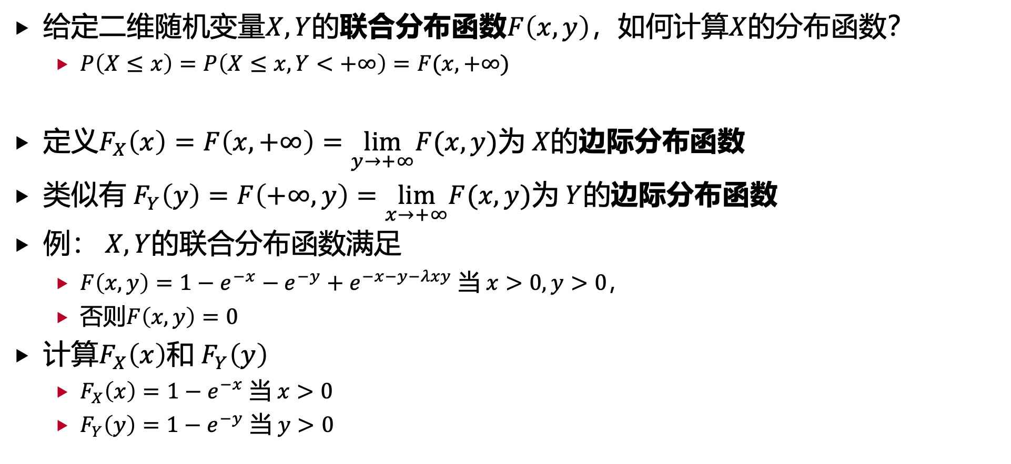
1. 多维连续随机变量的分布函数和密度函数
给定二维随机变量$X,Y$的联合分布函数$F\left(x,y\right)$，如何计算$X$的分布函数？
$P\left(X≤x\right)=P\left(X≤x,Y<+∞\right)=F(x,+∞)$
定义$F_{X}\left(x\right)=F\left(x,+∞\right)=\lim_{y→+∞}F(x,y)$为 $X$的边际分布函数
类似有 $F_{Y}\left(y\right)=F\left(+∞,y\right)=\lim_{x→+∞}F(x,y)$为 $Y$的边际分布函数
例： $X,Y$的联合分布函数满足
$F\left(x,y\right)=1−e^{−x}−e^{−y}+e^{−x−y−λxy}$ 当 $x>0,y>0$，
否则$F\left(x,y\right)=0$
计算$F_{X}\left(x\right)$和 $F_{Y}\left(y\right)$
$F_{X}\left(x\right)=1−e^{−x}$ 当 $x>0$
$F_{Y}\left(y\right)=1−e^{−y}$ 当 $y>0$

Slide 8
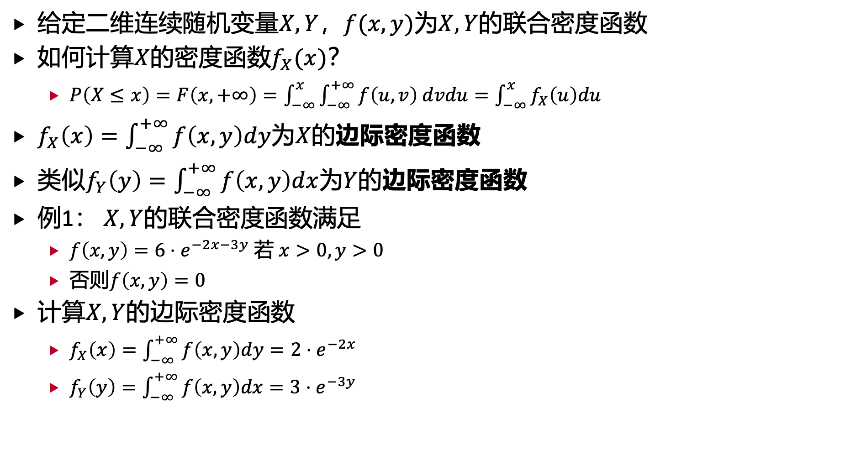
1. 多维连续随机变量的分布函数和密度函数
给定二维连续随机变量$X,Y$，$f(x,y)$为$X,Y$的联合密度函数
如何计算$X$的密度函数$f_{X}(x)$？
$P\left(X≤x\right)=F\left(x,+∞\right)=\int_{−∞}^{x}{\int_{−∞}^{+∞}{f\left(u,v\right) dvdu}}=\int_{−∞}^{x}{f_{X}\left(u\right)du}$
$f_{X}\left(x\right)=\int_{−∞}^{+∞}{f\left(x,y\right)dy}$为$X$的边际密度函数
类似$f_{Y}\left(y\right)=\int_{−∞}^{+∞}{f\left(x,y\right)dx}$为$Y$的边际密度函数
例1： $X,Y$的联合密度函数满足
$f\left(x,y\right)=6⋅e^{−2x−3y}$ 若 $x>0,y>0$
否则$f\left(x,y\right)=0$
计算$X,Y$的边际密度函数
$f_{X}\left(x\right)=\int_{−∞}^{+∞}{f\left(x,y\right)dy}=2⋅e^{−2x}$
$f_{Y}\left(y\right)=\int_{−∞}^{+∞}{f\left(x,y\right)dx}=3⋅e^{−3y}$

Slide 9
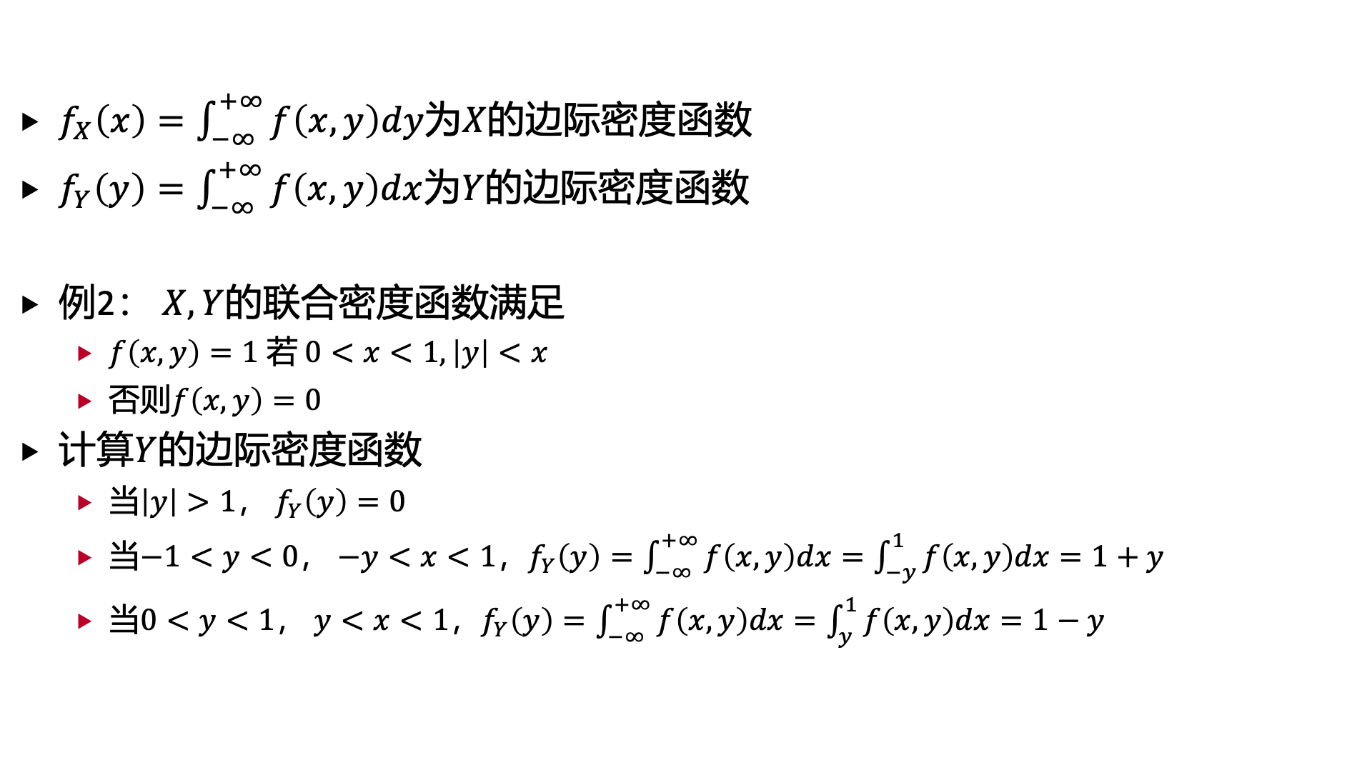
1. 多维连续随机变量的分布函数和密度函数
$f_{X}\left(x\right)=\int_{−∞}^{+∞}{f\left(x,y\right)dy}$为$X$的边际密度函数
$f_{Y}\left(y\right)=\int_{−∞}^{+∞}{f\left(x,y\right)dx}$为$Y$的边际密度函数
例2： $X,Y$的联合密度函数满足
$f\left(x,y\right)=1$ 若 $0<x<1,\left|y\right|<x$
否则$f\left(x,y\right)=0$
计算$Y$的边际密度函数
当$\left|y\right|>1， f_{Y}\left(y\right)=0$
当$−1<y<0$， $−y<x<1$，$f_{Y}\left(y\right)=\int_{−∞}^{+∞}{f\left(x,y\right)dx}=\int_{−y}^{1}{f\left(x,y\right)dx=1+y}$
当$0<y<1$， $y<x<1$，$f_{Y}\left(y\right)=\int_{−∞}^{+∞}{f\left(x,y\right)dx}=\int_{y}^{1}{f\left(x,y\right)dx=1−y}$

Slide 10
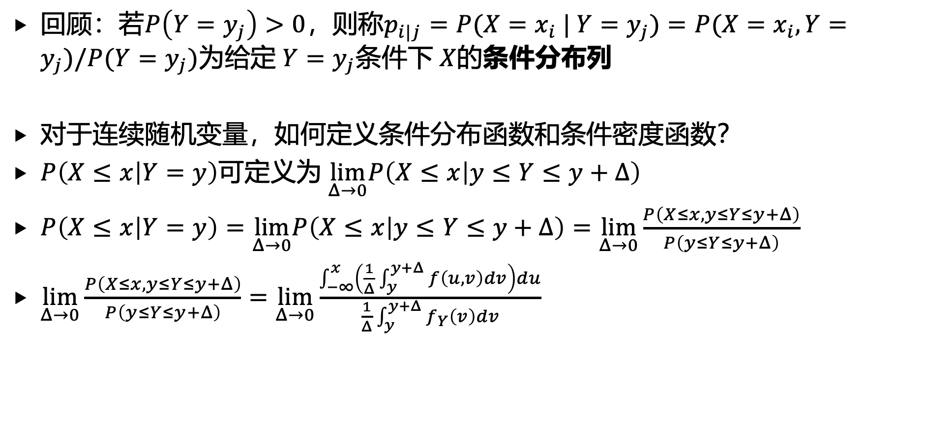
1. 多维连续随机变量的分布函数和密度函数
回顾：若$P\left(Y=y_{j}\right)>0$，则称$p_{i|j}=P(X=x_{i} | Y=y_{j})=P(X=x_{i},Y=y_{j})/P(Y=y_{j})$为给定 $Y=y_{j}$条件下 $X$的条件分布列
对于连续随机变量，如何定义条件分布函数和条件密度函数？
$P\left(X≤x | Y=y\right)$可定义为 $\lim_{Δ→0}P\left(X≤x | y≤Y≤y+Δ\right)$
$P\left(X≤x | Y=y\right)=\lim_{Δ→0}P\left(X≤x | y≤Y≤y+Δ\right)=\lim_{Δ→0}\frac{P\left(X≤x,y≤Y≤y+Δ\right)}{P\left(y≤Y≤y+Δ\right)}$
$\lim_{Δ→0}\frac{P\left(X≤x,y≤Y≤y+Δ\right)}{P\left(y≤Y≤y+Δ\right)}=\lim_{Δ→0}\frac{\int_{−∞}^{x}{\left(\frac{1}{Δ}\int_{y}^{y+Δ}{f\left(u,v\right)dv}\right)du}}{\frac{1}{Δ}\int_{y}^{y+Δ}{f_{Y}\left(v\right)dv}}$

Slide 11
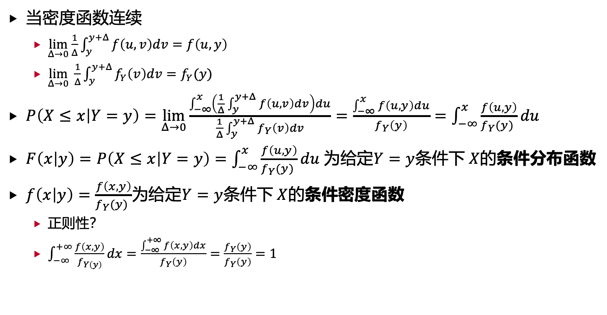
1. 多维连续随机变量的分布函数和密度函数
当密度函数连续
$\lim_{Δ→0}\frac{1}{Δ}\int_{y}^{y+Δ}{f\left(u,v\right)dv}=f\left(u,y\right)$
$\lim_{Δ→0} \frac{1}{Δ}\int_{y}^{y+Δ}{f_{Y}\left(v\right)dv}=f_{Y}(y)$
$P\left(X≤x | Y=y\right)=\lim_{Δ→0}\frac{\int_{−∞}^{x}{\left(\frac{1}{Δ}\int_{y}^{y+Δ}{f\left(u,v\right)dv}\right)du}}{\frac{1}{Δ}\int_{y}^{y+Δ}{f_{Y}\left(v\right)dv}}=\frac{\int_{−∞}^{x}{f\left(u,y\right)du}}{f_{Y}\left(y\right)}=\int_{−∞}^{x}{\frac{f\left(u,y\right)}{f_{Y}(y) }}du$
$F\left(x | y\right)=P\left(X≤x | Y=y\right)=\int_{−∞}^{x}{\frac{f\left(u,y\right)}{f_{Y}(y) }}du$为给定$Y=y$条件下 $X$的条件分布函数
$f\left(x | y\right)=\frac{f\left(x,y\right)}{f_{Y}(y) }$为给定$Y=y$条件下 $X$的条件密度函数
正则性？
$\int_{−∞}^{+∞}{\frac{f\left(x,y\right)}{f_{Y\left(y\right)}}}dx=\frac{\int_{−∞}^{+∞}{f\left(x,y\right)dx}}{f_{Y}\left(y\right)}=\frac{f_{Y}\left(y\right)}{f_{Y}\left(y\right)}=1$

Slide 12
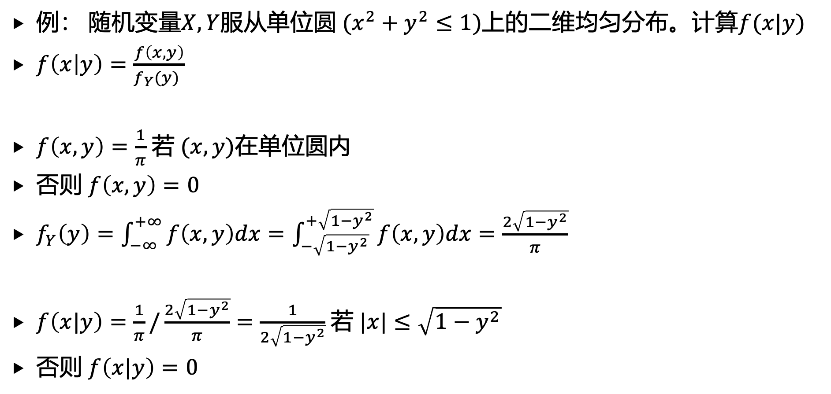
1. 多维连续随机变量的分布函数和密度函数
例： 随机变量$X,Y$服从单位圆$(x^{2}+y^{2}≤1)$上的二维均匀分布。计算$f(x|y)$
$f\left(x | y\right)=\frac{f\left(x,y\right)}{f_{Y}(y) }$
$f\left(x,y\right)=\frac{1}{π}$ 若 $(x,y)$在单位圆内
否则 $f\left(x,y\right)=0$
$f_{Y}\left(y\right)=\int_{−∞}^{+∞}{f\left(x,y\right)dx}=\int_{−\sqrt{1−y^{2}}}^{+\sqrt{1−y^{2}}}{f\left(x,y\right)dx}=\frac{2\sqrt{1−y^{2}}}{π}$
$f\left(x|y\right)=\frac{1}{π}/\frac{2\sqrt{1−y^{2}}}{π}=\frac{1}{2\sqrt{1−y^{2}}}$ 若 $|x|≤\sqrt{1−y^{2}}$
否则 $f\left(x|y\right)=0$

Slide 13
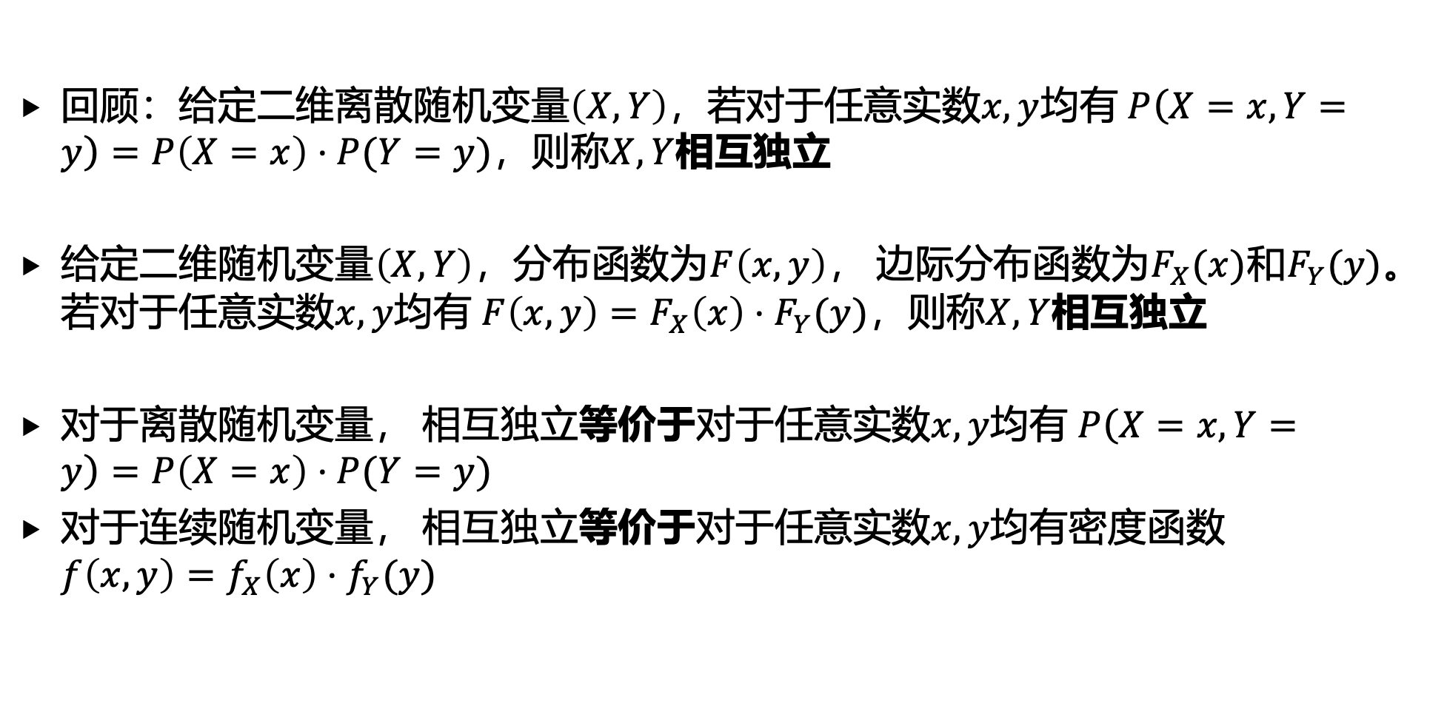
2. 多维连续随机变量的独立性
回顾：给定二维离散随机变量$\left(X,Y\right)$，若对于任意实数$x,y$均有 $P\left(X=x,Y=y\right)=P\left(X=x\right)⋅P(Y=y)$，则称$X,Y$相互独立
给定二维随机变量$\left(X,Y\right)$，分布函数为$F\left(x,y\right)$， 边际分布函数为$F_{X}(x)$和$F_{Y}(y)$。若对于任意实数$x,y$均有 $F\left(x,y\right)=F_{X}\left(x\right)⋅F_{Y}(y)$，则称$X,Y$相互独立
对于离散随机变量， 相互独立等价于对于任意实数$x,y$均有 $P\left(X=x,Y=y\right)=P\left(X=x\right)⋅P(Y=y)$
对于连续随机变量， 相互独立等价于对于任意实数$x,y$均有密度函数 $f\left(x,y\right)=f_{X}\left(x\right)⋅f_{Y}(y)$

Slide 14
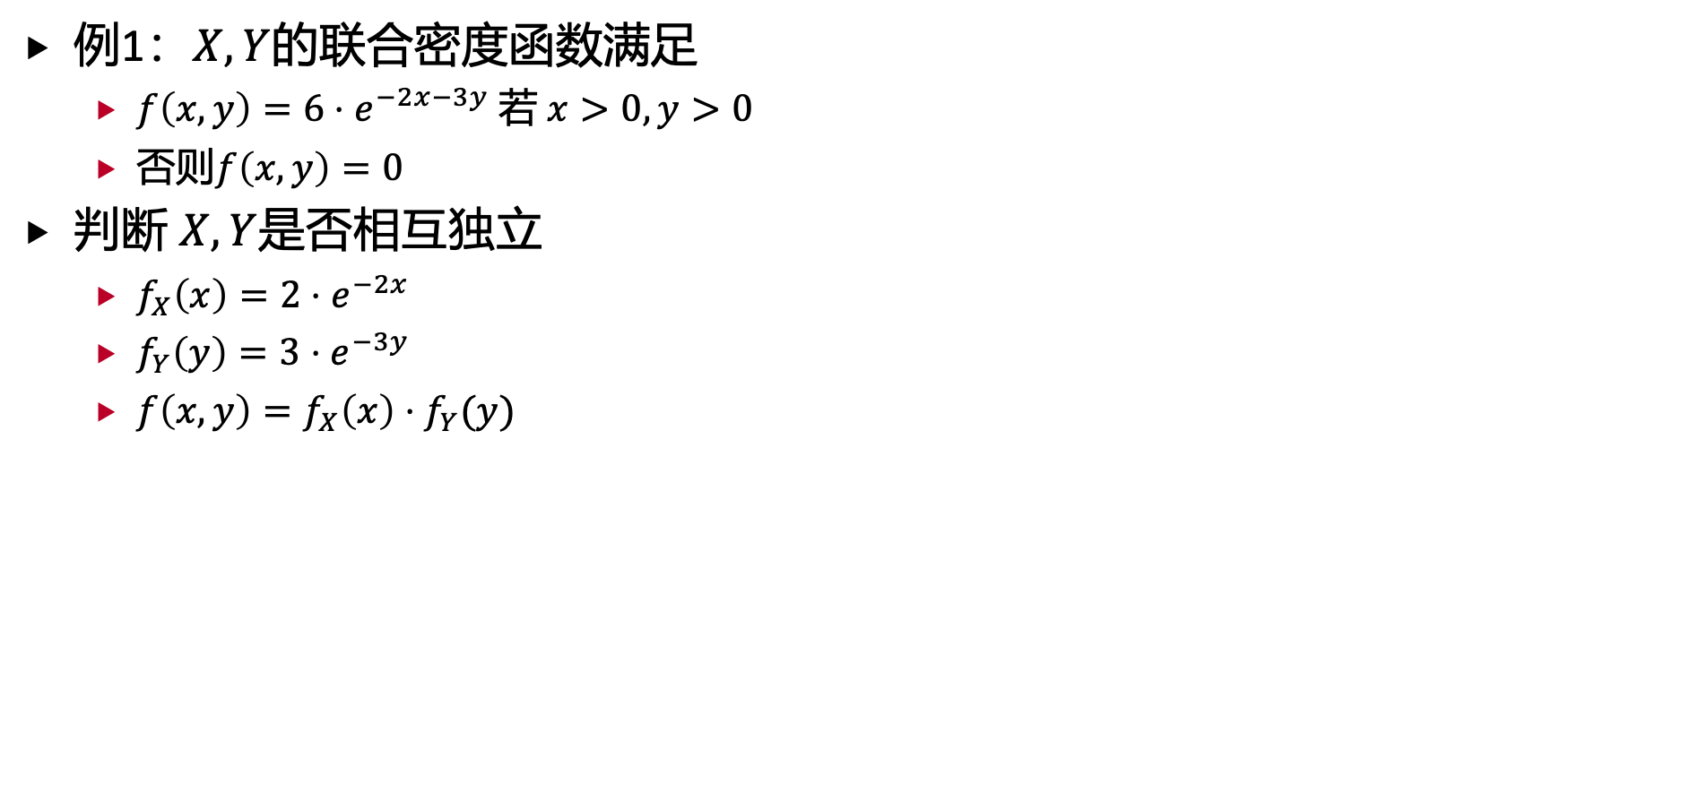
2. 多维连续随机变量的独立性
例1：$X,Y$的联合密度函数满足
$f\left(x,y\right)=6⋅e^{−2x−3y}$ 若 $x>0,y>0$
否则$f\left(x,y\right)=0$
判断 $X,Y$是否相互独立
$f_{X}\left(x\right)=2⋅e^{−2x}$
$f_{Y}\left(y\right)=3⋅e^{−3y}$
$f\left(x,y\right)=f_{X}\left(x\right)⋅f_{Y}(y)$

Slide 15
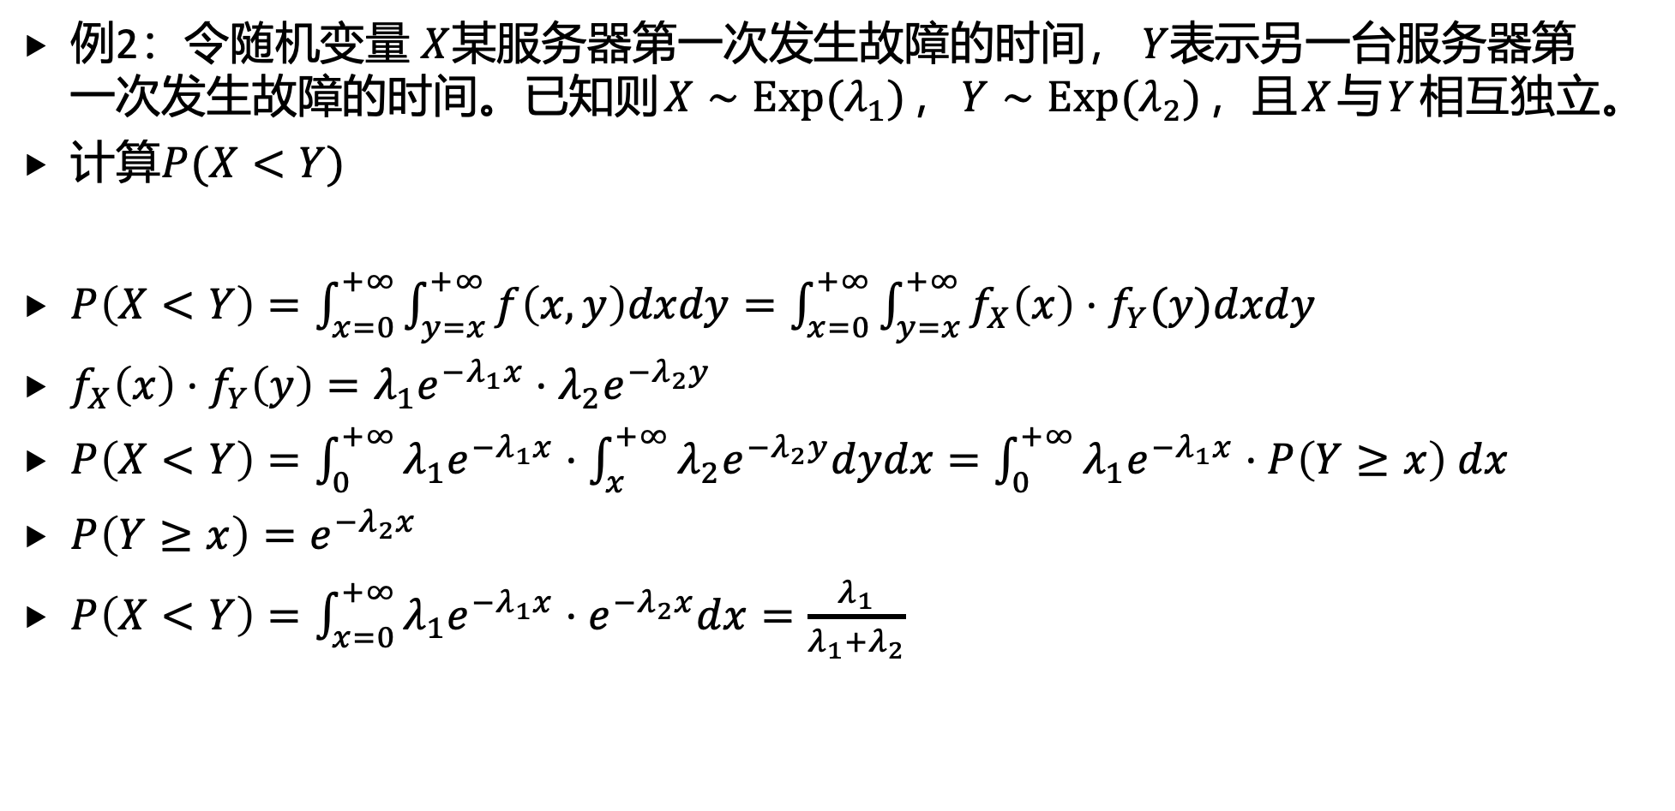
2. 多维连续随机变量的独立性
例2：令随机变量 $X$某服务器第一次发生故障的时间， $Y$表示另一台服务器第一次发生故障的时间。已知则$X∼Exp(λ_{1})$，$Y∼Exp(λ_{2})$，且$X$与$Y$相互独立。
计算$P(X<Y)$
$P\left(X<Y\right)=\int_{x=0}^{+∞}{\int_{y=x}^{+∞}{f\left(x,y\right)dxdy}}=\int_{x=0}^{+∞}{\int_{y=x}^{+∞}{f_{X}\left(x\right)⋅f_{Y}(y)dxdy}}$
$f_{X}\left(x\right)⋅f_{Y}\left(y\right)=λ_{1}e^{−λ_{1}x}⋅λ_{2}e^{−λ_{2}y}$
$P\left(X<Y\right)=\int_{0}^{+∞}{λ_{1}e^{−λ_{1}x}⋅\int_{x}^{+∞}{λ_{2}e^{−λ_{2}y}dydx}}=\int_{0}^{+∞}{λ_{1}e^{−λ_{1}x}⋅P\left(Y≥x\right) dx}$
$P\left(Y≥x\right)=e^{−λ_{2}x}$
$P\left(X<Y\right)=\int_{x=0}^{+∞}{λ_{1}e^{−λ_{1}x}⋅e^{−λ_{2}x}dx}=\frac{λ_{1}}{λ_{1}+λ_{2}}$

Slide 16
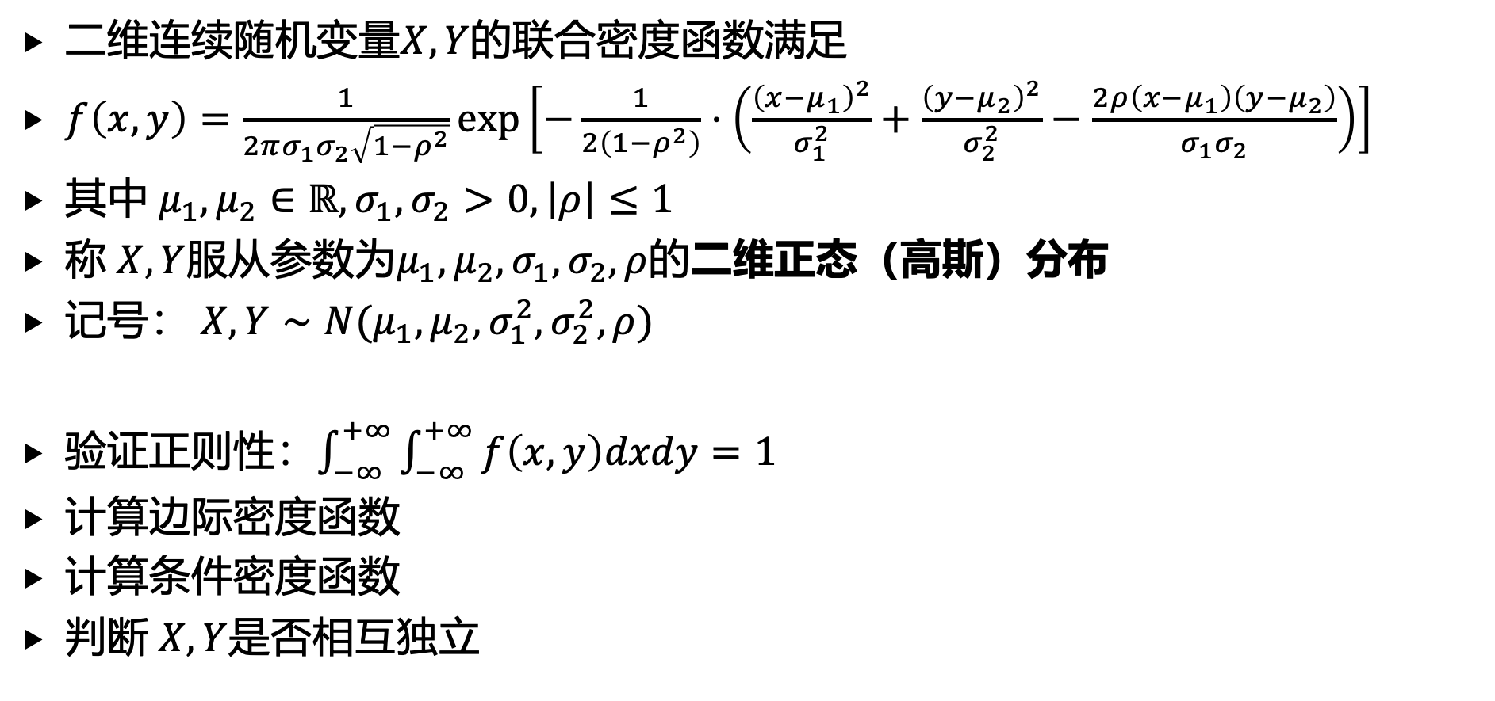
2. 多维连续随机变量的独立性
二维连续随机变量$X,Y$的联合密度函数满足
$f\left(x,y\right)=\frac{1}{2πσ_{1}σ_{2}\sqrt{1−ρ^{2}}}exp\left[−\frac{1}{2\left(1−ρ^{2}\right)}⋅\left(\frac{{\left(x−μ_{1}\right)}^{2}}{σ_{1}^{2}}+\frac{{\left(y−μ_{2}\right)}^{2}}{σ_{2}^{2}}−\frac{2ρ\left(x−μ_{1}\right)\left(y−μ_{2}\right)}{σ_{1}σ_{2}}\right)\right]$
其中 $μ_{1},μ_{2}∈ℝ,σ_{1},σ_{2}>0,\left|ρ\right|≤1$
称 $X,Y$服从参数为$μ_{1},μ_{2},σ_{1},σ_{2},ρ$的二维正态（高斯）分布
记号： $X,Y∼N(μ_{1},μ_{2},σ_{1}^{2},σ_{2}^{2},ρ)$
验证正则性：$\int_{−∞}^{+∞}{\int_{−∞}^{+∞}{f\left(x,y\right)dxdy}}=1$
计算边际密度函数
计算条件密度函数
判断 $X,Y$是否相互独立

Slide 17
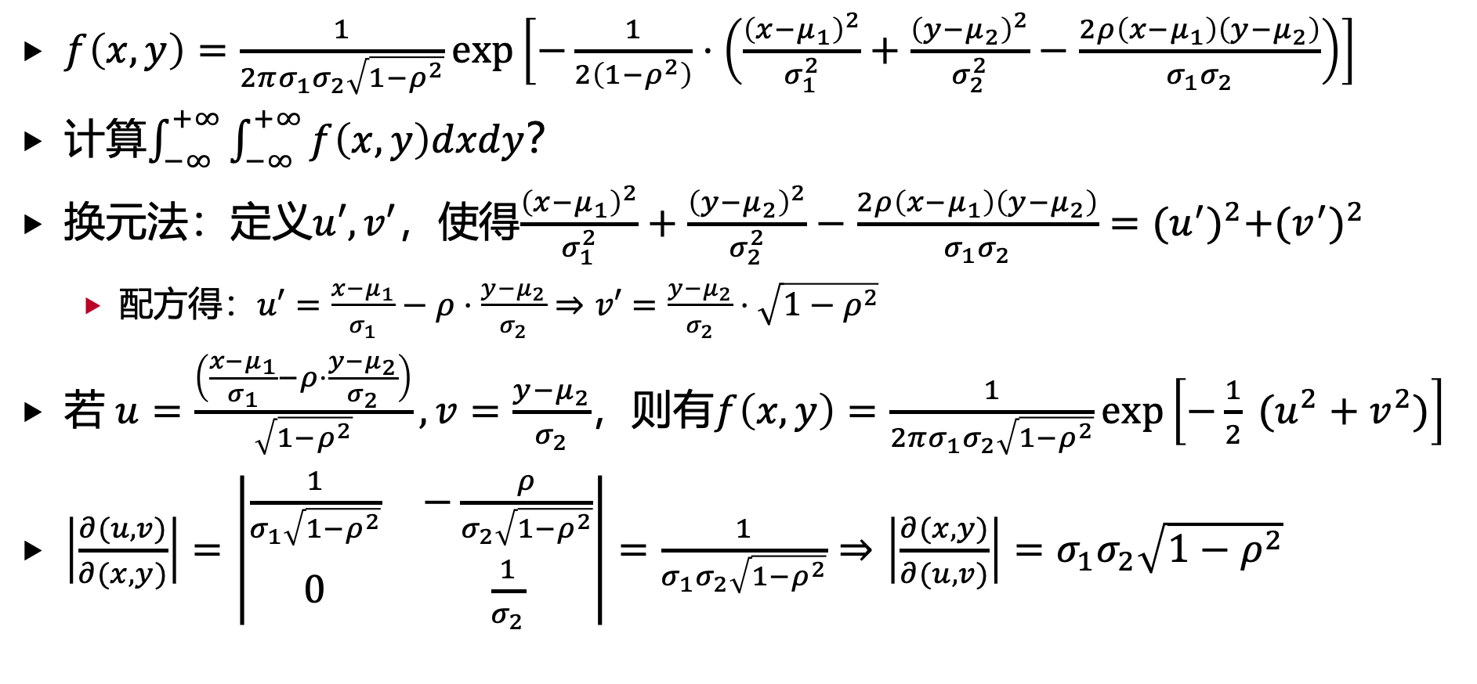
2. 多维连续随机变量的独立性
$f\left(x,y\right)=\frac{1}{2πσ_{1}σ_{2}\sqrt{1−ρ^{2}}}exp\left[−\frac{1}{2\left(1−ρ^{2}\right)}⋅\left(\frac{{\left(x−μ_{1}\right)}^{2}}{σ_{1}^{2}}+\frac{{\left(y−μ_{2}\right)}^{2}}{σ_{2}^{2}}−\frac{2ρ\left(x−μ_{1}\right)\left(y−μ_{2}\right)}{σ_{1}σ_{2}}\right)\right]$
计算$\int_{−∞}^{+∞}{\int_{−∞}^{+∞}{f\left(x,y\right)dxdy}}$？
换元法：定义$u′,v′$，使得$\frac{{\left(x−μ_{1}\right)}^{2}}{σ_{1}^{2}}+\frac{{\left(y−μ_{2}\right)}^{2}}{σ_{2}^{2}}−\frac{2ρ\left(x−μ_{1}\right)\left(y−μ_{2}\right)}{σ_{1}σ_{2}}={(u^{′})}^{2}+{(v^{′})}^{2}$
配方得：$u′=\frac{x−μ_{1}}{σ_{1}}−ρ⋅\frac{y−μ_{2}}{σ_{2}}⇒v′=\frac{y−μ_{2}}{σ_{2}}⋅\sqrt{1−ρ^{2}}$
若 $u=\frac{\left(\frac{x−μ_{1}}{σ_{1}}−ρ⋅\frac{y−μ_{2}}{σ_{2}}\right)}{\sqrt{1−ρ^{2}}},v=\frac{y−μ_{2}}{σ_{2}}$，则有$f\left(x,y\right)=\frac{1}{2πσ_{1}σ_{2}\sqrt{1−ρ^{2}}}exp\left[−\frac{1}{2} (u^{2}+v^{2})\right]$
$\left|\frac{∂(u,v)}{∂(x,y)}\right|=\left|\begin{matrix}\frac{1}{σ_{1}\sqrt{1−ρ^{2}}} & −\frac{ρ}{σ_{2}\sqrt{1−ρ^{2}}} \\ 0 & \frac{1}{σ_{2}}\end{matrix}\right|=\frac{1}{σ_{1}σ_{2}\sqrt{1−ρ^{2}}}⇒\left|\frac{∂(x,y)}{∂(u,v)}\right|=σ_{1}σ_{2}\sqrt{1−ρ^{2}}$

Slide 18
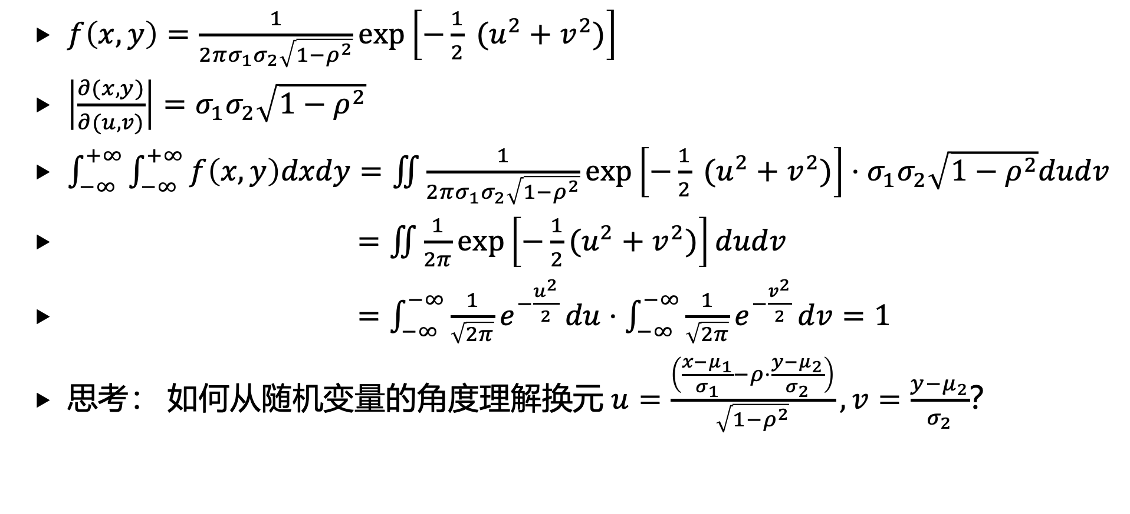
2. 多维连续随机变量的独立性
$f\left(x,y\right)=\frac{1}{2πσ_{1}σ_{2}\sqrt{1−ρ^{2}}}exp\left[−\frac{1}{2} (u^{2}+v^{2})\right]$
$\left|\frac{∂(x,y)}{∂(u,v)}\right|=σ_{1}σ_{2}\sqrt{1−ρ^{2}}$
$\int_{−∞}^{+∞}{\int_{−∞}^{+∞}{f\left(x,y\right)dxdy}}=\iint{\frac{1}{2πσ_{1}σ_{2}\sqrt{1−ρ^{2}}}exp\left[−\frac{1}{2} (u^{2}+v^{2})\right]⋅σ_{1}σ_{2}\sqrt{1−ρ^{2}}dudv}$
$=\iint{\frac{1}{2π}exp\left[−\frac{1}{2}(u^{2}+v^{2})\right]dudv}$
$=\int_{−∞}^{−∞}{\frac{1}{\sqrt{2π}}e^{−\frac{u^{2}}{2}}}du⋅\int_{−∞}^{−∞}{\frac{1}{\sqrt{2π}}e^{−\frac{v^{2}}{2}}}dv=1$
思考： 如何从随机变量的角度理解换元 $u=\frac{\left(\frac{x−μ_{1}}{σ_{1}}−ρ⋅\frac{y−μ_{2}}{σ_{2}}\right)}{\sqrt{1−ρ^{2}}},v=\frac{y−μ_{2}}{σ_{2}}$？

Slide 19
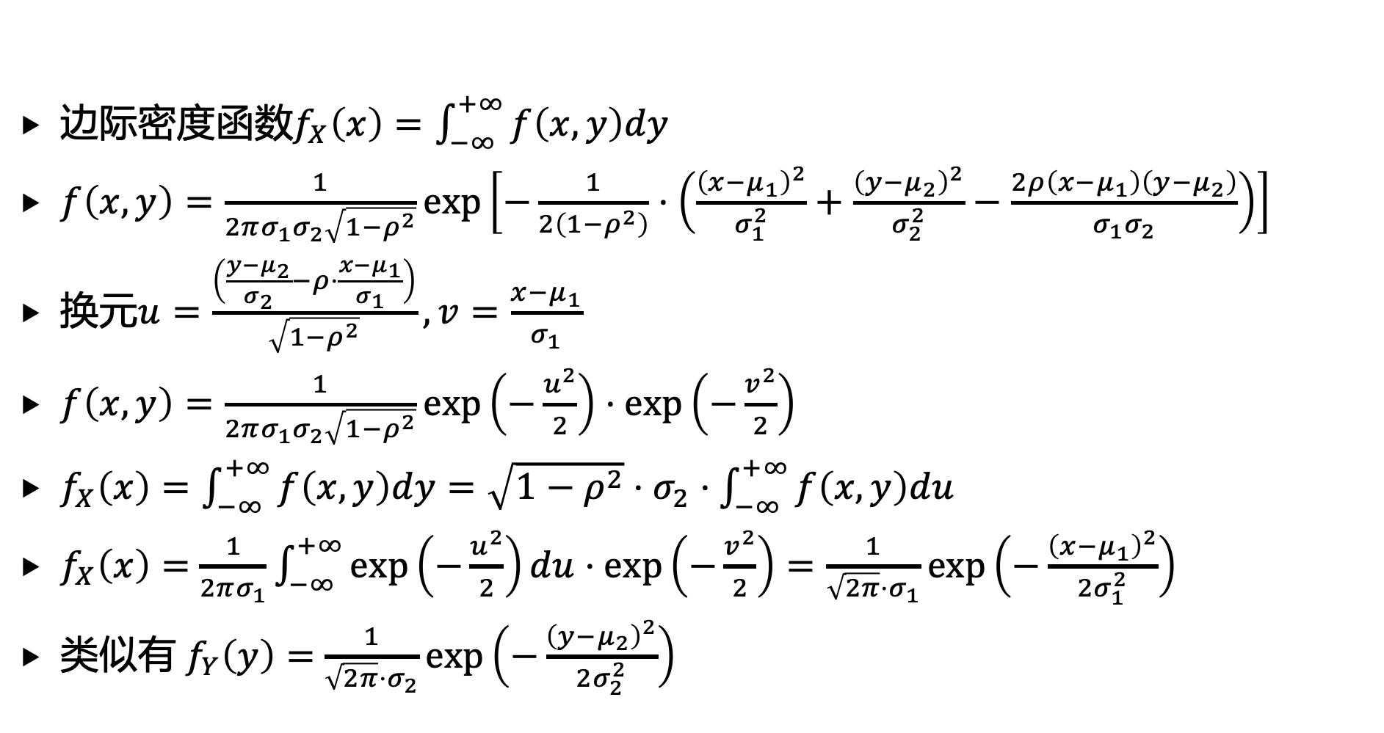
2. 多维连续随机变量的独立性
边际密度函数$f_{X}\left(x\right)=\int_{−∞}^{+∞}{f\left(x,y\right)dy}$
$f\left(x,y\right)=\frac{1}{2πσ_{1}σ_{2}\sqrt{1−ρ^{2}}}exp\left[−\frac{1}{2\left(1−ρ^{2}\right)}⋅\left(\frac{{\left(x−μ_{1}\right)}^{2}}{σ_{1}^{2}}+\frac{{\left(y−μ_{2}\right)}^{2}}{σ_{2}^{2}}−\frac{2ρ\left(x−μ_{1}\right)\left(y−μ_{2}\right)}{σ_{1}σ_{2}}\right)\right]$
换元$u=\frac{\left(\frac{y−μ_{2}}{σ_{2}}−ρ⋅\frac{x−μ_{1}}{σ_{1}}\right)}{\sqrt{1−ρ^{2}}},v=\frac{x−μ_{1}}{σ_{1}}$
$f\left(x,y\right)=\frac{1}{2πσ_{1}σ_{2}\sqrt{1−ρ^{2}}}exp\left(−\frac{u^{2}}{2}\right)⋅exp\left(−\frac{v^{2}}{2}\right)$
$f_{X}\left(x\right)=\int_{−∞}^{+∞}{f\left(x,y\right)dy}=\sqrt{1−ρ^{2}}⋅σ_{2}⋅\int_{−∞}^{+∞}{f\left(x,y\right)du}$
$f_{X}\left(x\right)=$ $\frac{1}{2πσ_{1}}\int_{−∞}^{+∞}{exp\left(−\frac{u^{2}}{2}\right)du}⋅exp\left(−\frac{v^{2}}{2}\right)=\frac{1}{\sqrt{2π}⋅σ_{1}}exp\left(−\frac{{\left(x−μ_{1}\right)}^{2}}{2σ_{1}^{2}}\right)$
类似有 $f_{Y}\left(y\right)=$ $\frac{1}{\sqrt{2π}⋅σ_{2}}exp\left(−\frac{{\left(y−μ_{2}\right)}^{2}}{2σ_{2}^{2}}\right)$

Slide 20
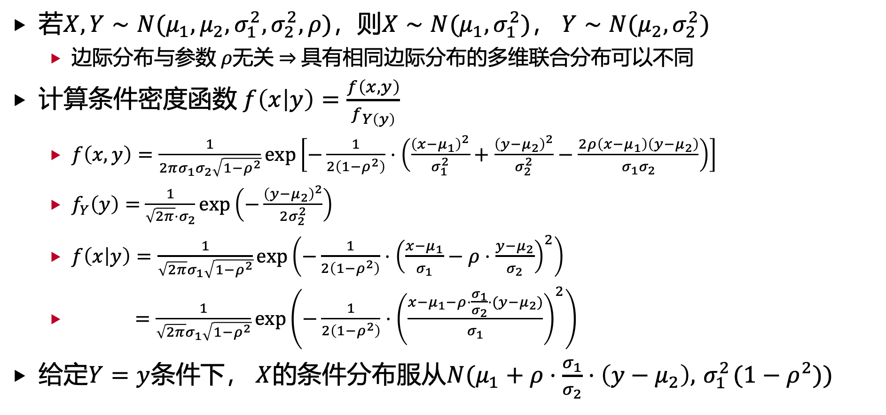
2. 多维连续随机变量的独立性
若$X,Y∼N(μ_{1},μ_{2},σ_{1}^{2},σ_{2}^{2},ρ)$，则$X∼N(μ_{1},σ_{1}^{2})$， $Y∼N(μ_{2},σ_{2}^{2})$
边际分布与参数 $ρ$无关 $⇒$具有相同边际分布的多维联合分布可以不同
计算条件密度函数 $f\left(x | y\right)=\frac{f\left(x,y\right)}{f_{Y\left(y\right)}}$
$f\left(x,y\right)=\frac{1}{2πσ_{1}σ_{2}\sqrt{1−ρ^{2}}}exp\left[−\frac{1}{2\left(1−ρ^{2}\right)}⋅\left(\frac{{\left(x−μ_{1}\right)}^{2}}{σ_{1}^{2}}+\frac{{\left(y−μ_{2}\right)}^{2}}{σ_{2}^{2}}−\frac{2ρ\left(x−μ_{1}\right)\left(y−μ_{2}\right)}{σ_{1}σ_{2}}\right)\right]$
$f_{Y}\left(y\right)=$ $\frac{1}{\sqrt{2π}⋅σ_{2}}exp\left(−\frac{{\left(y−μ_{2}\right)}^{2}}{2σ_{2}^{2}}\right)$
$f\left(x | y\right)=\frac{1}{\sqrt{2π}σ_{1}\sqrt{1−ρ^{2}}}exp\left(−\frac{1}{2\left(1−ρ^{2}\right)}⋅{\left(\frac{x−μ_{1}}{σ_{1}}−ρ⋅\frac{y−μ_{2}}{σ_{2}}\right)}^{2}\right)$
$=\frac{1}{\sqrt{2π}σ_{1}\sqrt{1−ρ^{2}}}exp\left(−\frac{1}{2\left(1−ρ^{2}\right)}⋅{\left(\frac{x−μ_{1}−ρ⋅\frac{σ_{1}}{σ_{2}}⋅(y−μ_{2})}{σ_{1}}\right)}^{2}\right)$
给定$Y=y$条件下， $X$的条件分布服从$N(μ_{1}+ρ⋅\frac{σ_{1}}{σ_{2}}⋅\left(y−μ_{2}\right),{ σ}_{1}^{2}(1−ρ^{2}))$

Slide 21
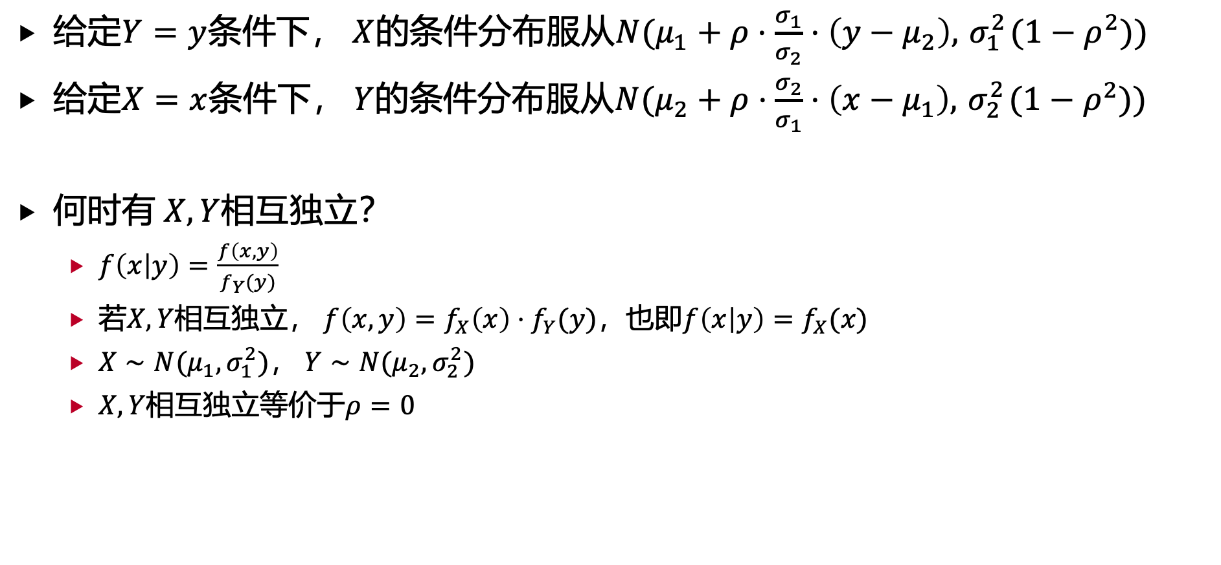
2. 多维连续随机变量的独立性
给定$Y=y$条件下， $X$的条件分布服从$N(μ_{1}+ρ⋅\frac{σ_{1}}{σ_{2}}⋅\left(y−μ_{2}\right),{ σ}_{1}^{2}(1−ρ^{2}))$
给定$X=x$条件下， $Y$的条件分布服从$N(μ_{2}+ρ⋅\frac{σ_{2}}{σ_{1}}⋅\left(x−μ_{1}\right),{ σ}_{2}^{2}(1−ρ^{2}))$
何时有 $X,Y$相互独立？
$f\left(x | y\right)=\frac{f\left(x,y\right)}{f_{Y}(y)}$
若$X,Y$相互独立， $f\left(x,y\right)=f_{X}\left(x\right)⋅f_{Y}(y)$，也即$f\left(x | y\right)=f_{X}(x)$
$X∼N(μ_{1},σ_{1}^{2})$， $Y∼N(μ_{2},σ_{2}^{2})$
$X,Y$相互独立等价于$ρ=0$

Slide 22
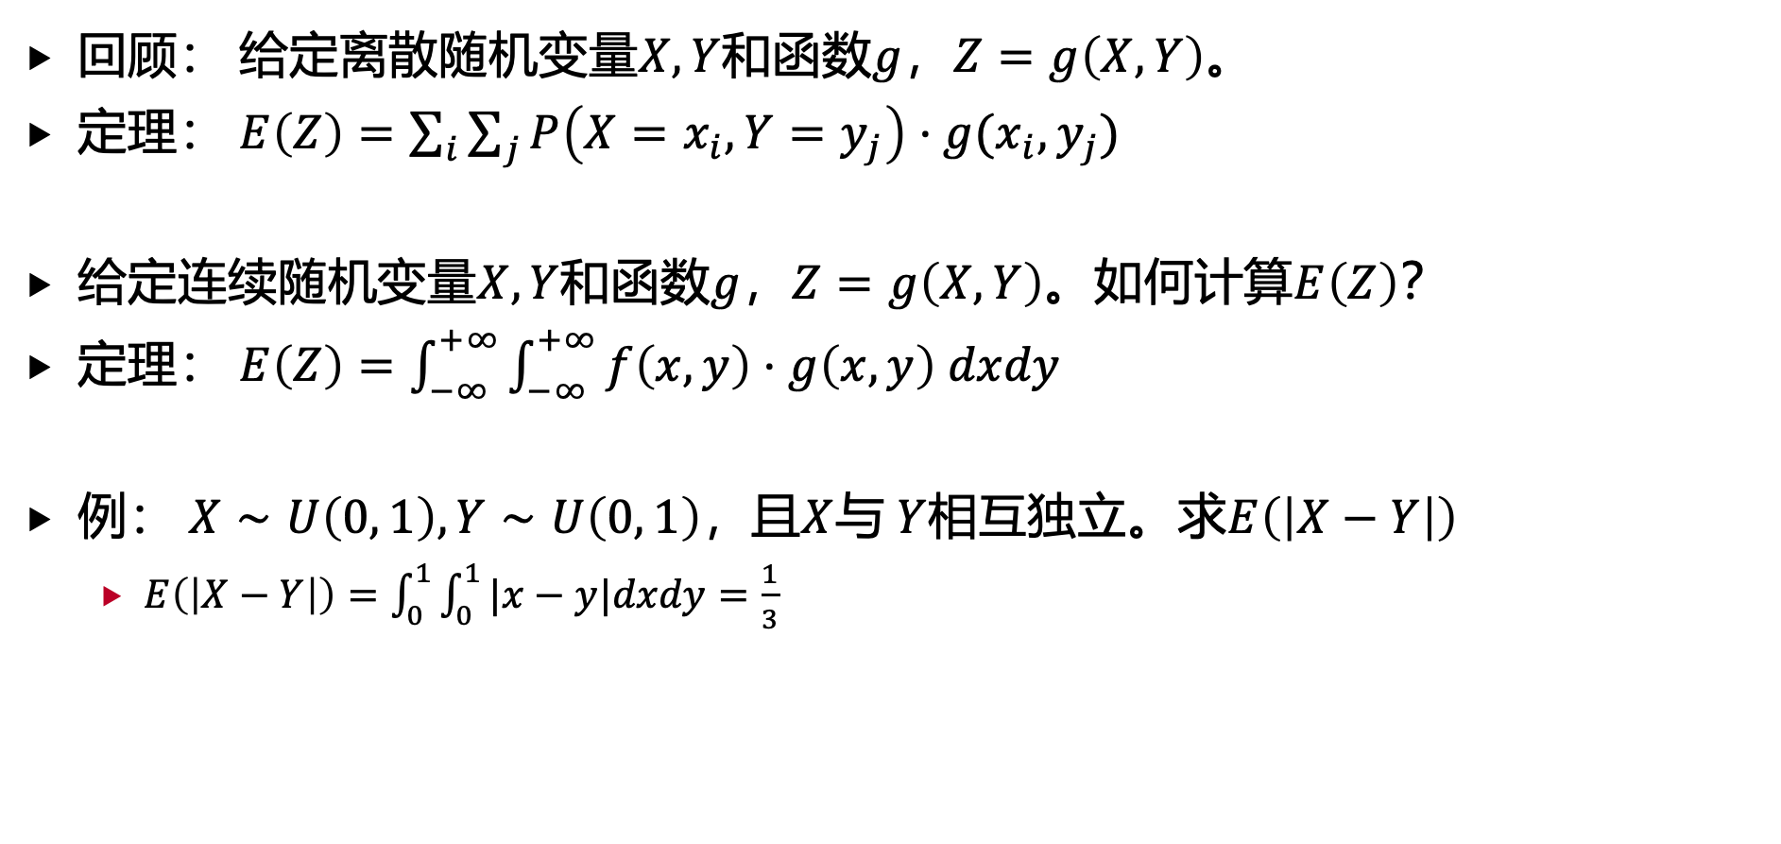
3. 多维连续随机变量的特征数
回顾： 给定离散随机变量$X,Y$和函数$g$，$Z=g\left(X,Y\right)$。
定理： $E\left(Z\right)=\sum_{i}{\sum_{j}{P\left(X=x_{i},Y=y_{j}\right)⋅g(x_{i},y_{j})}}$
给定连续随机变量$X,Y$和函数$g$，$Z=g\left(X,Y\right)$。如何计算$E\left(Z\right)$？
定理： $E\left(Z\right)=\int_{−∞}^{+∞}{\int_{−∞}^{+∞}{f\left(x,y\right)⋅g\left(x,y\right) dxdy}}$
例： $X∼U\left(0, 1\right), Y∼U\left(0, 1\right)$，且$X$与 $Y$相互独立。求$E\left(\left|X−Y\right|\right)$
$E\left(\left|X−Y\right|\right)=\int_{0}^{1}{\int_{0}^{1}{|x−y|dxdy}=\frac{1}{3}}$

Slide 23
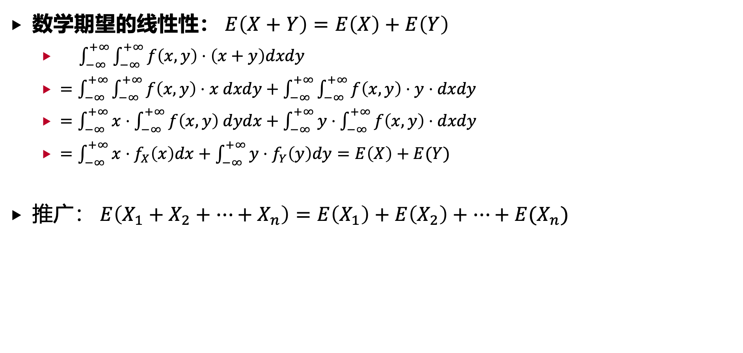
3. 多维连续随机变量的特征数
数学期望的线性性： $E\left(X+Y\right)=E\left(X\right)+E\left(Y\right)$
$\int_{−∞}^{+∞}{\int_{−∞}^{+∞}{f\left(x,y\right)⋅\left(x+y\right)dxdy}}$
$=\int_{−∞}^{+∞}{\int_{−∞}^{+∞}{f\left(x,y\right)⋅x dxdy}}+\int_{−∞}^{+∞}{\int_{−∞}^{+∞}{f\left(x,y\right)⋅y⋅dxdy}}$
$=\int_{−∞}^{+∞}{x⋅\int_{−∞}^{+∞}{f\left(x,y\right) dydx}}+\int_{−∞}^{+∞}{y⋅\int_{−∞}^{+∞}{f\left(x,y\right)⋅dxdy}}$
$=\int_{−∞}^{+∞}{x⋅f_{X}\left(x\right)dx}+\int_{−∞}^{+∞}{y⋅f_{Y}\left(y\right)dy}=E\left(X\right)+E(Y)$
推广： $E\left(X_{1}+X_{2}+⋯+X_{n}\right)=E\left(X_{1}\right)+E\left(X_{2}\right)+⋯+E(X_{n})$

Slide 24
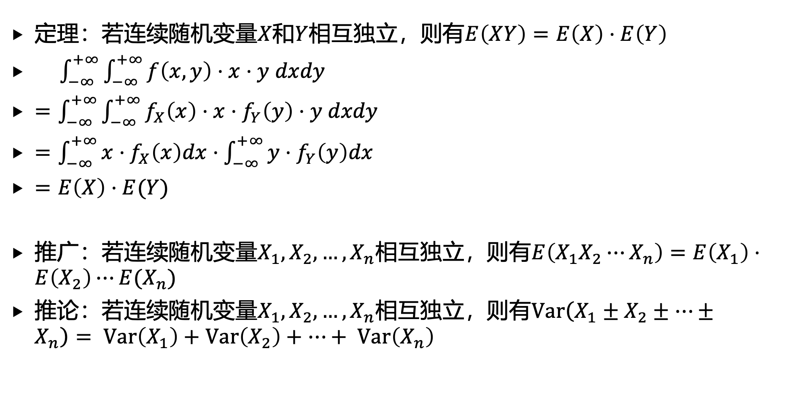
3. 多维连续随机变量的特征数
定理：若连续随机变量$X$和$Y$相互独立，则有$E\left(XY\right)=E\left(X\right)⋅E\left(Y\right)$
$\int_{−∞}^{+∞}{\int_{−∞}^{+∞}{f\left(x,y\right)⋅x⋅y dxdy}}$
$=\int_{−∞}^{+∞}{\int_{−∞}^{+∞}{f_{X}\left(x\right)⋅x⋅f_{Y}\left(y\right)⋅y dxdy}}$
$=\int_{−∞}^{+∞}{x⋅f_{X}\left(x\right)dx}⋅\int_{−∞}^{+∞}{y⋅f_{Y}\left(y\right)dx}$
$=E\left(X\right)⋅E(Y)$
推广：若连续随机变量$X_{1},X_{2},…,X_{n}$相互独立，则有$E\left(X_{1}X_{2}⋯X_{n}\right)=E\left(X_{1}\right)⋅E\left(X_{2}\right)⋯E(X_{n})$
推论：若连续随机变量$X_{1},X_{2},…,X_{n}$相互独立，则有$Var\left(X_{1}±X_{2}±⋯±X_{n}\right)= Var\left(X_{1}\right)+Var\left(X_{2}\right)+⋯+ Var\left(X_{n}\right)$

Slide 25
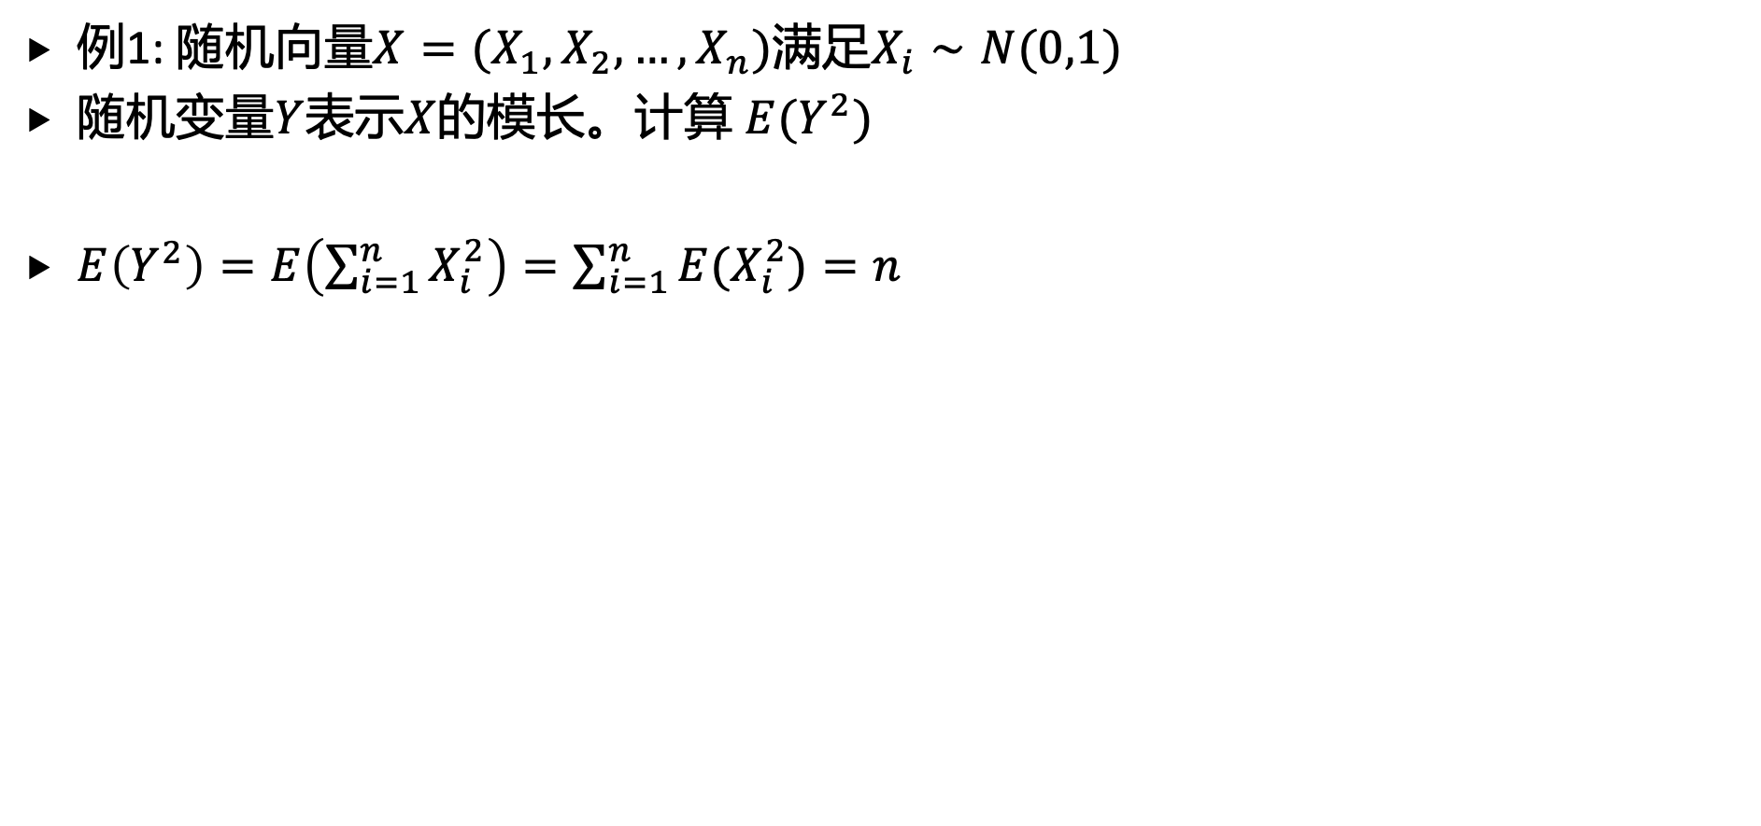
3. 多维连续随机变量的特征数
例1: 随机向量$X=(X_{1},X_{2},…,X_{n})$满足$X_{i}∼N(0,1)$
随机变量$Y$表示$X$的模长。计算 $E(Y^{2})$
$E\left(Y^{2}\right)=E\left(\sum_{i=1}^{n}{X_{i}^{2}}\right)=\sum_{i=1}^{n}{E(X_{i}^{2})}=n$

Slide 26
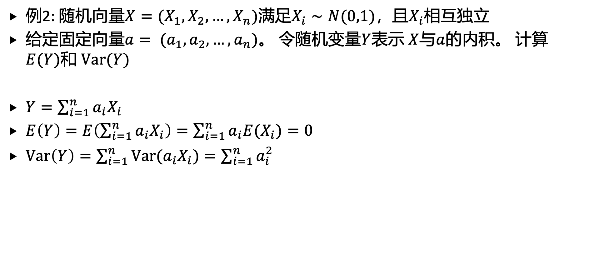
3. 多维连续随机变量的特征数
例2: 随机向量$X=(X_{1},X_{2},…,X_{n})$满足$X_{i}∼N(0,1)$，且$X_{i}$相互独立
给定固定向量$a= (a_{1},a_{2},…,a_{n})$。 令随机变量$Y$表示 $X$与$a$的内积。 计算 $E(Y)$和 $Var(Y)$
$Y=\sum_{i=1}^{n}{a_{i}X_{i}}$
$E\left(Y\right)=E\left(\sum_{i=1}^{n}{a_{i}X_{i}}\right)=\sum_{i=1}^{n}{a_{i}E(X_{i})}=0$
$Var\left(Y\right)=\sum_{i=1}^{n}{Var(a_{i}X_{i})}=\sum_{i=1}^{n}{a_{i}^{2}}$

Slide 27
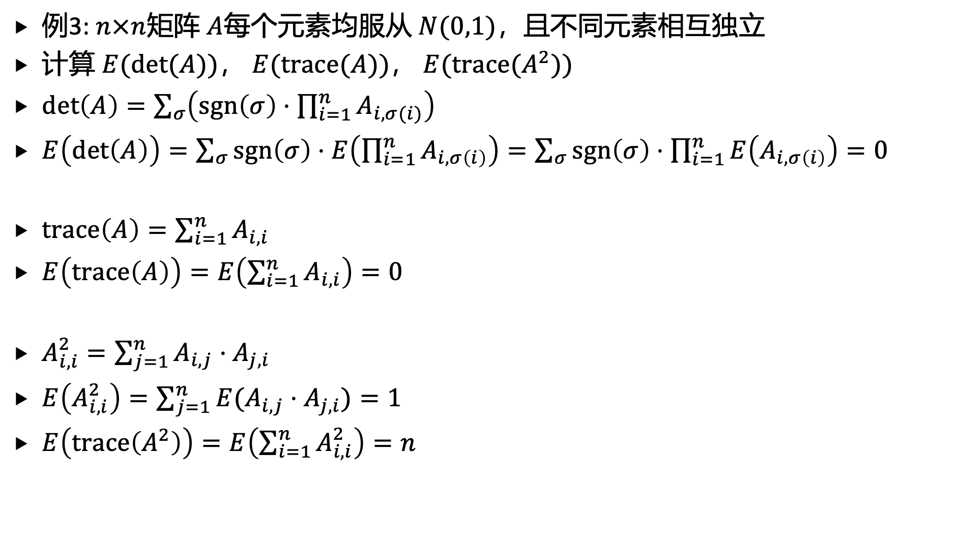
3. 多维连续随机变量的特征数
例3: $n×n$矩阵 $A$每个元素均服从 $N(0,1)$，且不同元素相互独立
计算 $E(det(A))$， $E(trace(A))$， $E(trace(A^{2}))$
$det\left(A\right)=\sum_{σ}{\left(sgn\left(σ\right)⋅\prod_{i=1}^{n}{A_{i,σ(i)}}\right)}$
$E\left(det\left(A\right)\right)=\sum_{σ}{sgn\left(σ\right)⋅E\left(\prod_{i=1}^{n}{A_{i,σ\left(i\right)}}\right)}=\sum_{σ}{sgn\left(σ\right)⋅\prod_{i=1}^{n}{E\left(A_{i,σ\left(i\right)}\right)}=0}$
$trace\left(A\right)=\sum_{i=1}^{n}{A_{i,i}}$
$E\left(trace\left(A\right)\right)=E\left(\sum_{i=1}^{n}{A_{i,i}}\right)=0$
$A_{i,i}^{2}=\sum_{j=1}^{n}{A_{i,j}⋅A_{j,i}}$
$E\left(A_{i,i}^{2}\right)=\sum_{j=1}^{n}{E(A_{i,j}⋅A_{j,i}})=1$
$E\left(trace\left(A^{2}\right)\right)=E\left(\sum_{i=1}^{n}{A_{i,i}^{2}}\right)=n$

Slide 28
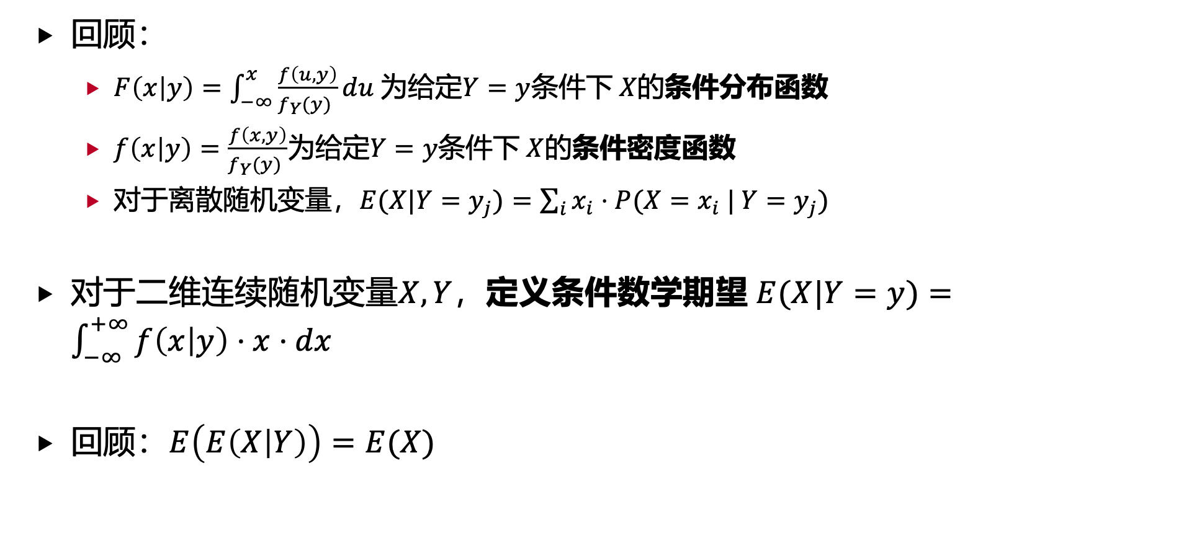
3. 多维连续随机变量的特征数
回顾：
$F\left(x | y\right)=\int_{−∞}^{x}{\frac{f\left(u,y\right)}{f_{Y}(y) }}du$为给定$Y=y$条件下 $X$的条件分布函数
$f\left(x | y\right)=\frac{f\left(x,y\right)}{f_{Y}(y) }$为给定$Y=y$条件下 $X$的条件密度函数
对于离散随机变量，$E(X|Y=y_{j})=\sum_{i}{x_{i}⋅P(X=x_{i} | Y=y_{j})}$
对于二维连续随机变量$X,Y$，定义条件数学期望 $E(X|Y=y)=\int_{−∞}^{+∞}{f\left(x | y\right)⋅x⋅dx}$
回顾：$E\left(E\left(X | Y\right)\right)=E(X)$

Slide 29
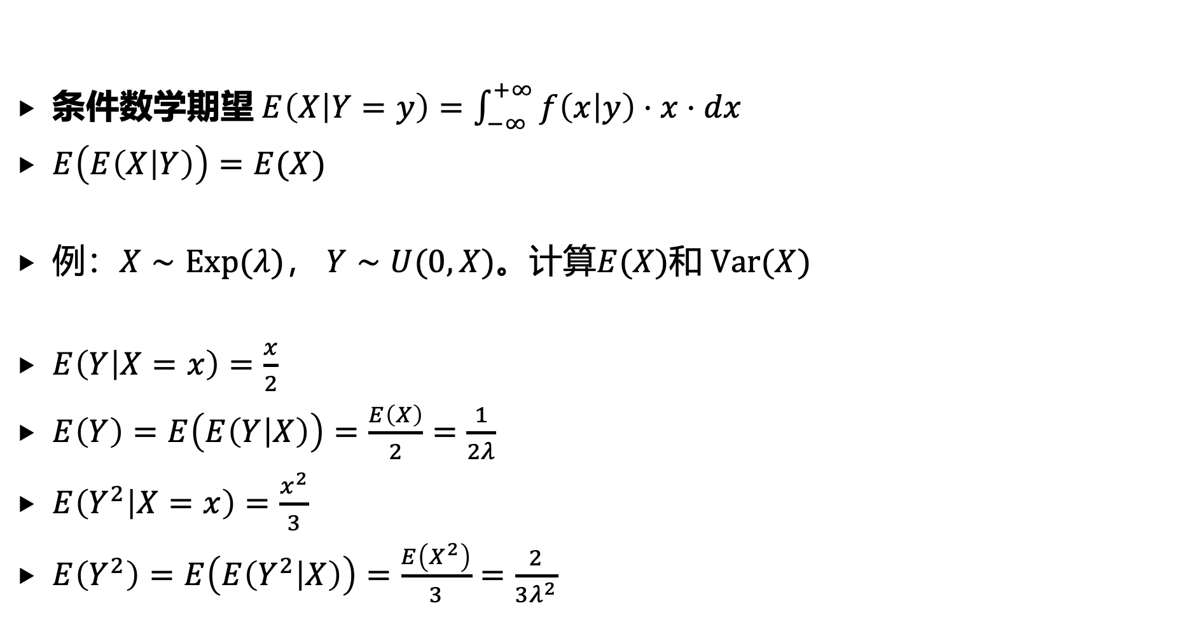
3. 多维连续随机变量的特征数
条件数学期望 $E\left(X | Y=y\right)=\int_{−∞}^{+∞}{f\left(x | y\right)⋅x⋅dx}$
$E\left(E\left(X | Y\right)\right)=E(X)$
例：$X∼Exp(λ)$， $Y∼U(0, X)$。计算$E(X)$和 $Var(X)$
$E\left(Y | X=x\right)=\frac{x}{2}$
$E\left(Y\right)=E\left(E\left(Y | X\right)\right)=\frac{E\left(X\right)}{2}=\frac{1}{2λ}$
$E\left(Y^{2} | X=x\right)=\frac{x^{2}}{3}$
$E\left(Y^{2}\right)=E\left(E\left(Y^{2} | X\right)\right)=\frac{E\left(X^{2}\right)}{3}=\frac{2}{3λ^{2}}$

Slide 30
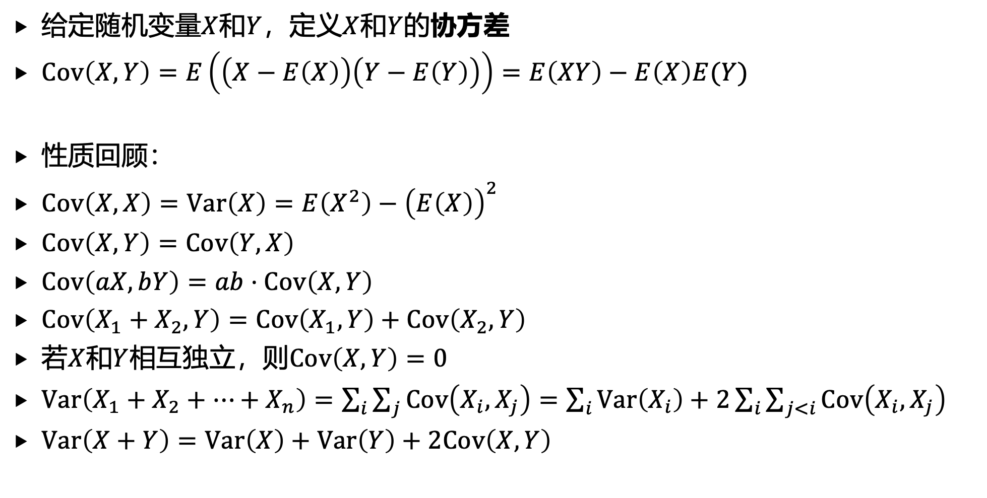
3. 多维连续随机变量的特征数
给定随机变量$X$和$Y$，定义$X$和$Y$的协方差
$Cov\left(X,Y\right)=E\left(\left(X−E\left(X\right)\right)\left(Y−E\left(Y\right)\right)\right)=E\left(XY\right)−E\left(X\right)E(Y)$
性质回顾：
$Cov\left(X,X\right)=Var\left(X\right)=E\left(X^{2}\right)−{\left(E\left(X\right)\right)}^{2}$
$Cov\left(X,Y\right)=Cov\left(Y,X\right)$
$Cov\left(aX,bY\right)=ab⋅Cov\left(X,Y\right)$
$Cov\left(X_{1}+X_{2},Y\right)=Cov\left(X_{1},Y\right)+Cov\left(X_{2},Y\right)$
若$X$和$Y$相互独立，则$Cov\left(X,Y\right)=0$
$Var\left(X_{1}+X_{2}+⋯+X_{n}\right)=\sum_{i}{\sum_{j}{Cov\left(X_{i},X_{j}\right)}=\sum_{i}{Var\left(X_{i}\right)+2\sum_{i}{\sum_{j<i}{Cov\left(X_{i},X_{j}\right)}}}}$
$Var\left(X+Y\right)=Var\left(X\right)+Var\left(Y\right)+2Cov\left(X,Y\right)$

Slide 31
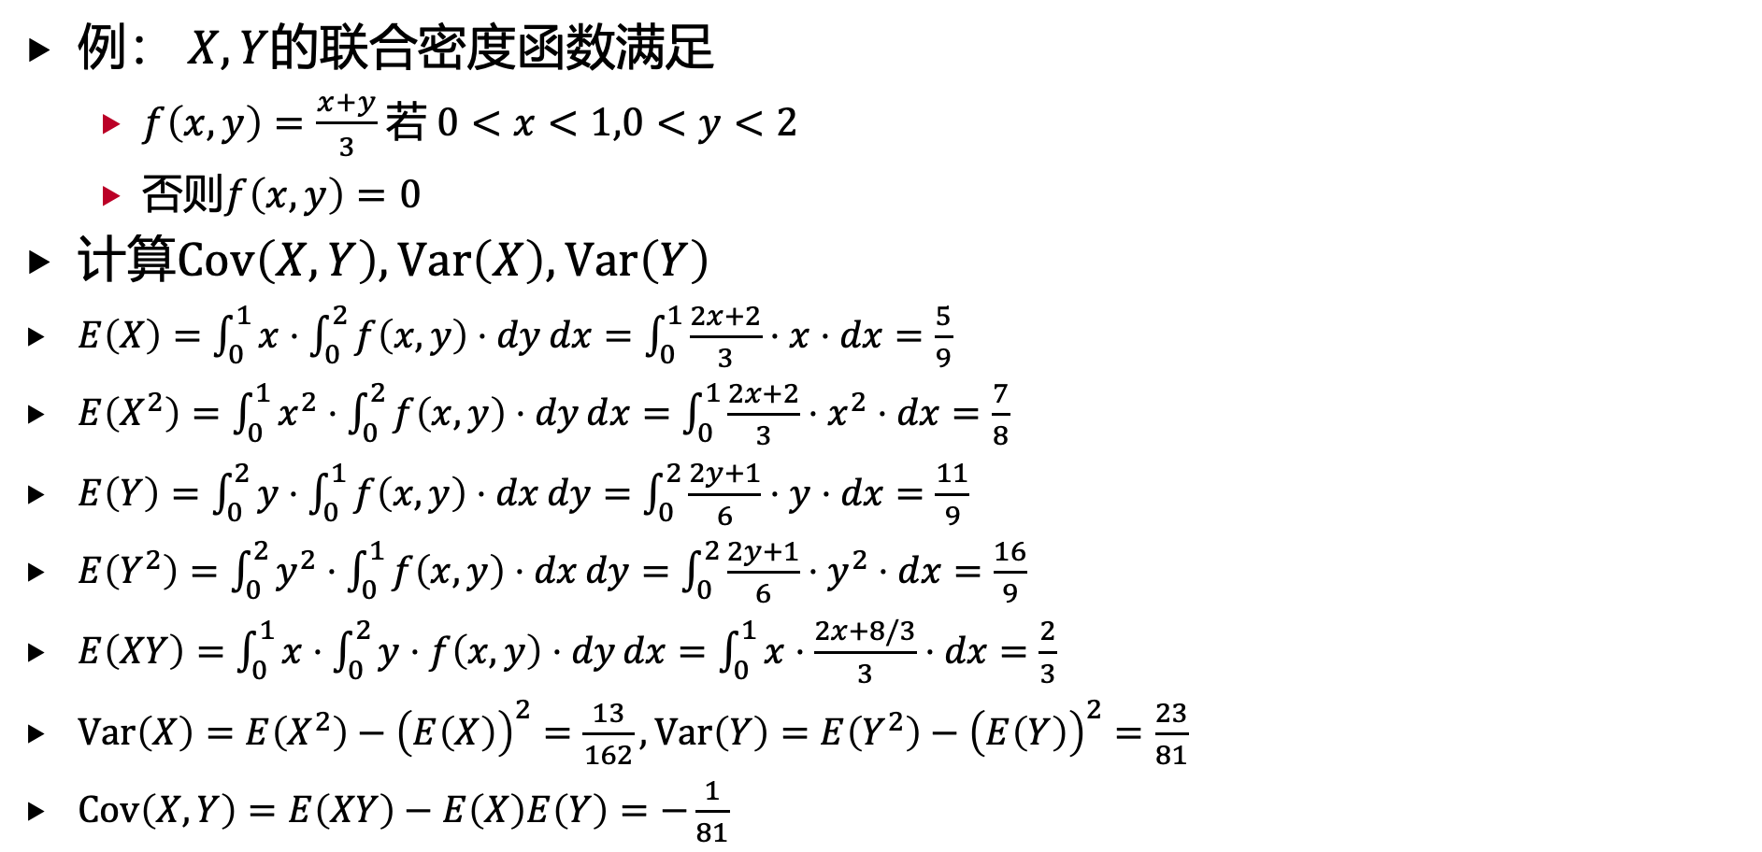
3. 多维连续随机变量的特征数
例： $X,Y$的联合密度函数满足
$f\left(x,y\right)=\frac{x+y}{3}$ 若 $0<x<1,0<y<2$
否则$f\left(x,y\right)=0$
计算$Cov\left(X,Y\right),Var\left(X\right),Var\left(Y\right)$
$E\left(X\right)=\int_{0}^{1}{x⋅\int_{0}^{2}{f\left(x,y\right)⋅dy}}dx=\int_{0}^{1}{\frac{2x+2}{3}⋅x⋅dx}=\frac{5}{9}$
$E\left(X^{2}\right)=\int_{0}^{1}{x^{2}⋅\int_{0}^{2}{f\left(x,y\right)⋅dy}}dx=\int_{0}^{1}{\frac{2x+2}{3}⋅x^{2}⋅dx}=\frac{7}{8}$
$E\left(Y\right)=\int_{0}^{2}{y⋅\int_{0}^{1}{f\left(x,y\right)⋅dx}}dy=\int_{0}^{2}{\frac{2y+1}{6}⋅y⋅dx}=\frac{11}{9}$
$E\left(Y^{2}\right)=\int_{0}^{2}{y^{2}⋅\int_{0}^{1}{f\left(x,y\right)⋅dx}}dy=\int_{0}^{2}{\frac{2y+1}{6}⋅y^{2}⋅dx}=\frac{16}{9}$
$E\left(XY\right)=\int_{0}^{1}{x⋅\int_{0}^{2}{y⋅f\left(x,y\right)⋅dy}}dx=\int_{0}^{1}{x⋅\frac{2x+8/3}{3}}⋅dx=\frac{2}{3}$
$Var\left(X\right)=E\left(X^{2}\right)−{\left(E\left(X\right)\right)}^{2}=\frac{13}{162},Var\left(Y\right)=E\left(Y^{2}\right)−{\left(E\left(Y\right)\right)}^{2}=\frac{23}{81}$
$Cov\left(X,Y\right)=E\left(XY\right)−E\left(X\right)E\left(Y\right)=−\frac{1}{81}$

Slide 32
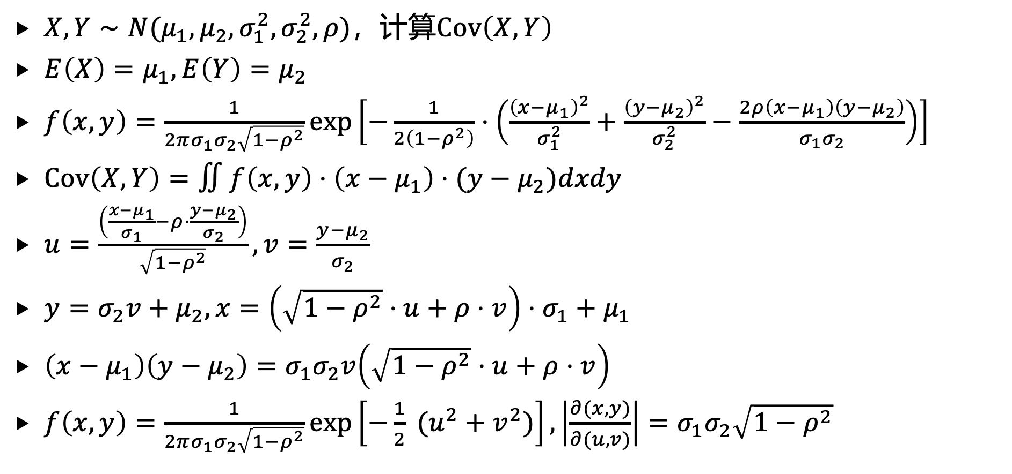
3. 多维连续随机变量的特征数
$X,Y∼N(μ_{1},μ_{2},σ_{1}^{2},σ_{2}^{2},ρ)$，计算$Cov\left(X,Y\right)$
$E\left(X\right)=μ_{1},E\left(Y\right)=μ_{2}$
$f\left(x,y\right)=\frac{1}{2πσ_{1}σ_{2}\sqrt{1−ρ^{2}}}exp\left[−\frac{1}{2\left(1−ρ^{2}\right)}⋅\left(\frac{{\left(x−μ_{1}\right)}^{2}}{σ_{1}^{2}}+\frac{{\left(y−μ_{2}\right)}^{2}}{σ_{2}^{2}}−\frac{2ρ\left(x−μ_{1}\right)\left(y−μ_{2}\right)}{σ_{1}σ_{2}}\right)\right]$
$Cov\left(X,Y\right)=∬f\left(x,y\right)⋅\left(x−μ_{1}\right)⋅(y−μ_{2})dxdy$
$u=\frac{\left(\frac{x−μ_{1}}{σ_{1}}−ρ⋅\frac{y−μ_{2}}{σ_{2}}\right)}{\sqrt{1−ρ^{2}}},v=\frac{y−μ_{2}}{σ_{2}}$
$y=σ_{2}v+μ_{2},x=\left(\sqrt{1−ρ^{2}}⋅u+ρ⋅v\right)⋅σ_{1}+μ_{1}$
$\left(x−μ_{1}\right)\left(y−μ_{2}\right)=σ_{1}σ_{2}v\left(\sqrt{1−ρ^{2}}⋅u+ρ⋅v\right)$
$f\left(x,y\right)=\frac{1}{2πσ_{1}σ_{2}\sqrt{1−ρ^{2}}}exp\left[−\frac{1}{2} (u^{2}+v^{2})\right],\left|\frac{∂(x,y)}{∂(u,v)}\right|=σ_{1}σ_{2}\sqrt{1−ρ^{2}}$

Slide 33
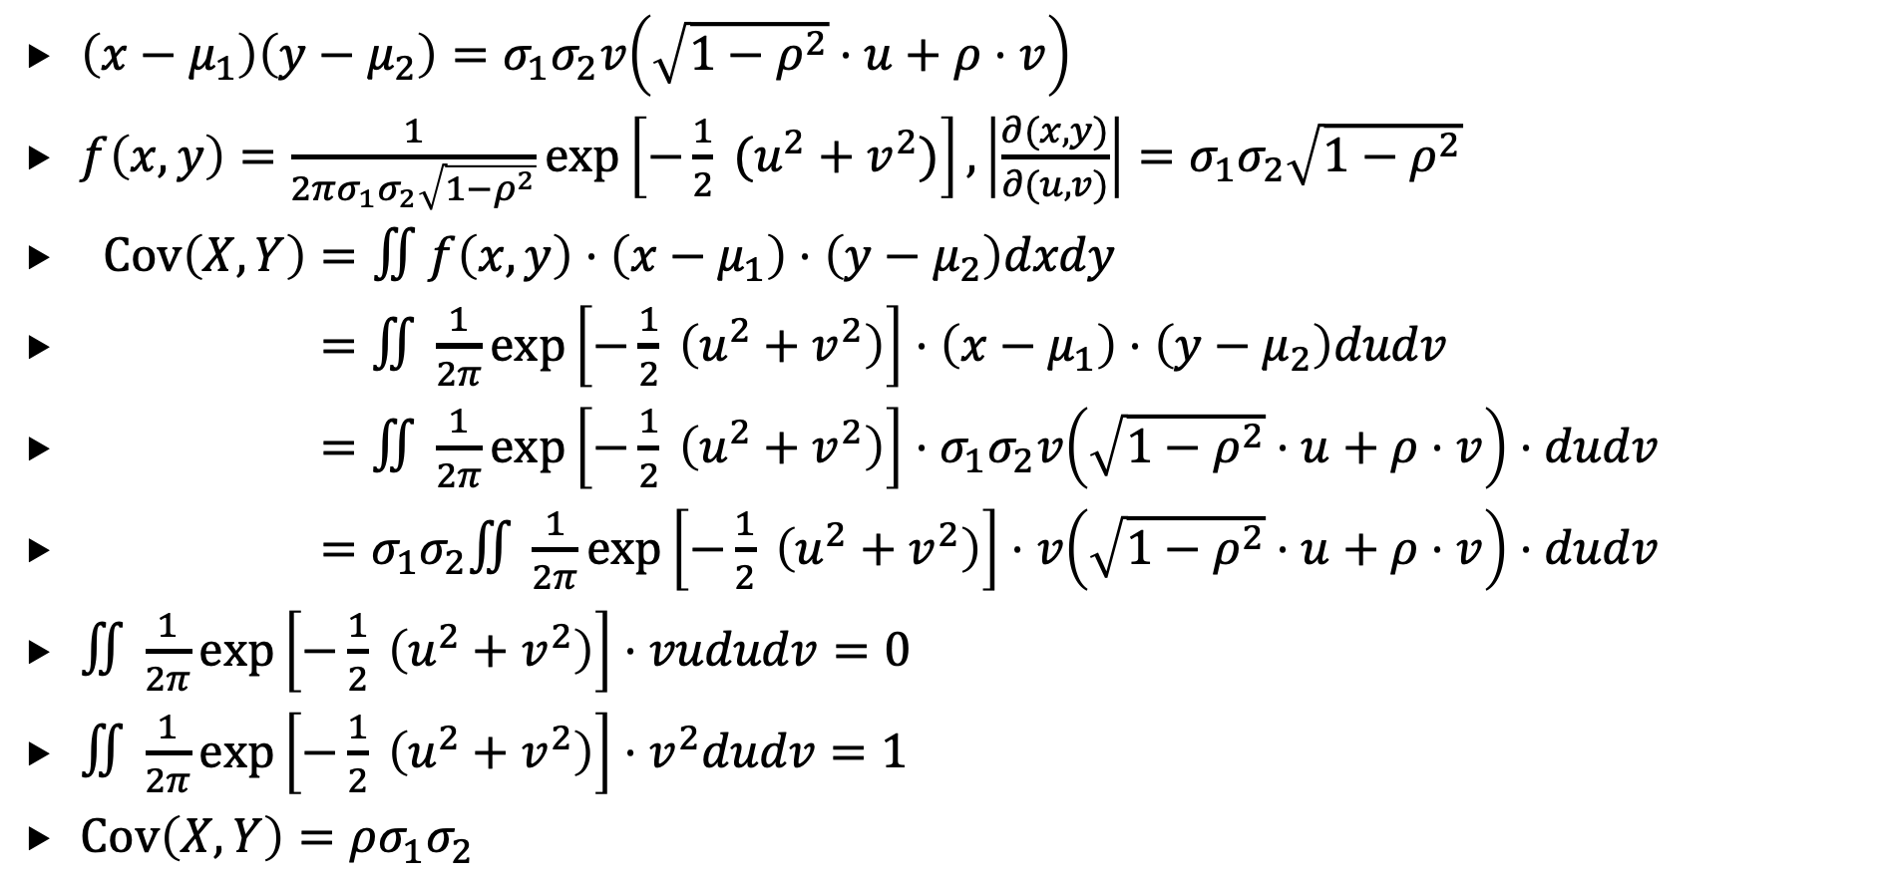
3. 多维连续随机变量的特征数
$\left(x−μ_{1}\right)\left(y−μ_{2}\right)=σ_{1}σ_{2}v\left(\sqrt{1−ρ^{2}}⋅u+ρ⋅v\right)$
$f\left(x,y\right)=\frac{1}{2πσ_{1}σ_{2}\sqrt{1−ρ^{2}}}exp\left[−\frac{1}{2} (u^{2}+v^{2})\right],\left|\frac{∂(x,y)}{∂(u,v)}\right|=σ_{1}σ_{2}\sqrt{1−ρ^{2}}$
$Cov\left(X,Y\right)=∬f\left(x,y\right)⋅\left(x−μ_{1}\right)⋅\left(y−μ_{2}\right)dxdy$
$=∬\frac{1}{2π}exp\left[−\frac{1}{2} \left(u^{2}+v^{2}\right)\right]⋅\left(x−μ_{1}\right)⋅\left(y−μ_{2}\right)dudv$
$=∬\frac{1}{2π}exp\left[−\frac{1}{2} \left(u^{2}+v^{2}\right)\right]⋅σ_{1}σ_{2}v\left(\sqrt{1−ρ^{2}}⋅u+ρ⋅v\right)⋅dudv$
$=σ_{1}σ_{2}∬\frac{1}{2π}exp\left[−\frac{1}{2} \left(u^{2}+v^{2}\right)\right]⋅v\left(\sqrt{1−ρ^{2}}⋅u+ρ⋅v\right)⋅dudv$
$∬\frac{1}{2π}exp\left[−\frac{1}{2} \left(u^{2}+v^{2}\right)\right]⋅vududv=0$
$∬\frac{1}{2π}exp\left[−\frac{1}{2} \left(u^{2}+v^{2}\right)\right]⋅v^{2}dudv=1$
$Cov\left(X,Y\right)=ρσ_{1}σ_{2}$

Slide 34
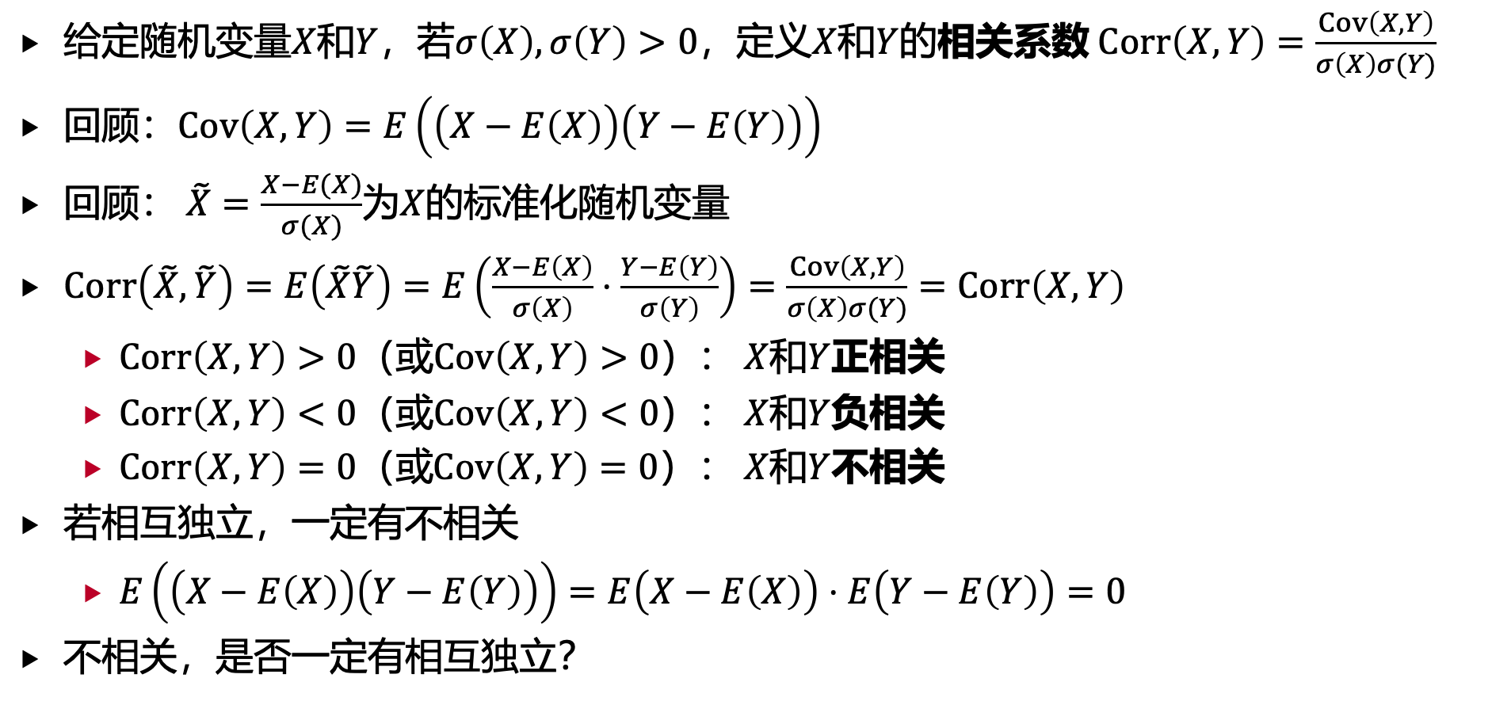
3. 多维连续随机变量的特征数
给定随机变量$X$和$Y$，若$σ\left(X\right),σ\left(Y\right)>0$，定义$X$和$Y$的相关系数 $Corr\left(X,Y\right)=\frac{Cov\left(X,Y\right)}{σ\left(X\right)σ(Y)}$
回顾：$Cov\left(X,Y\right)=E\left(\left(X−E\left(X\right)\right)\left(Y−E\left(Y\right)\right)\right)$
回顾： $\tilde{X}=\frac{X−E(X)}{σ(X)}$为$X$的标准化随机变量
$Corr\left(\tilde{X},\tilde{Y}\right)=E\left(\tilde{X}\tilde{Y}\right)=E\left(\frac{X−E\left(X\right)}{σ\left(X\right)}⋅\frac{Y−E\left(Y\right)}{σ\left(Y\right)}\right)=\frac{Cov\left(X,Y\right)}{σ\left(X\right)σ(Y)}=Corr\left(X,Y\right)$
$Corr\left(X,Y\right)>0$（或$Cov\left(X,Y\right)>0$）： $X$和$Y$正相关
$Corr\left(X,Y\right)<0$（或$Cov\left(X,Y\right)<0$）： $X$和$Y$负相关
$Corr\left(X,Y\right)=0$（或$Cov\left(X,Y\right)=0$）： $X$和$Y$不相关
若相互独立，一定有不相关
$E\left(\left(X−E\left(X\right)\right)\left(Y−E\left(Y\right)\right)\right)=E\left(X−E\left(X\right)\right)⋅E\left(Y−E\left(Y\right)\right)=0$
不相关，是否一定有相互独立？

Slide 35
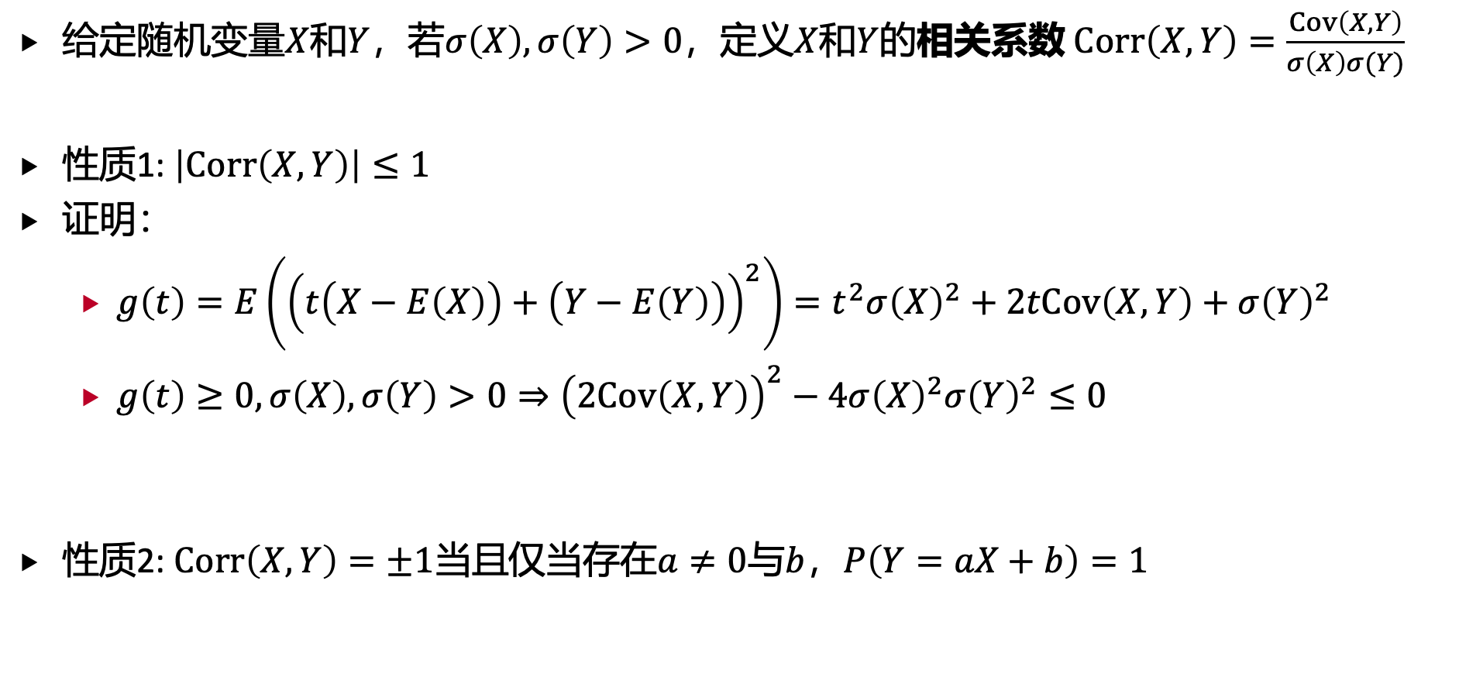
3. 多维连续随机变量的特征数
给定随机变量$X$和$Y$，若$σ\left(X\right),σ\left(Y\right)>0$，定义$X$和$Y$的相关系数 $Corr\left(X,Y\right)=\frac{Cov\left(X,Y\right)}{σ\left(X\right)σ(Y)}$
性质1: $\left|Corr\left(X,Y\right)\right|≤1$
证明：
$g\left(t\right)=E\left({\left(t\left(X−E\left(X\right)\right)+\left(Y−E\left(Y\right)\right)\right)}^{2}\right)=t^{2}σ{\left(X\right)}^{2}+2tCov\left(X,Y\right)+σ{\left(Y\right)}^{2}$
$g\left(t\right)≥0,σ\left(X\right),σ\left(Y\right)>0⇒{\left(2Cov\left(X,Y\right)\right)}^{2}−4σ{\left(X\right)}^{2}σ{\left(Y\right)}^{2}≤0$
性质2: $Corr\left(X,Y\right)=±1$当且仅当存在$a≠0$与$b$，$P\left(Y=aX+b\right)=1$

Slide 36
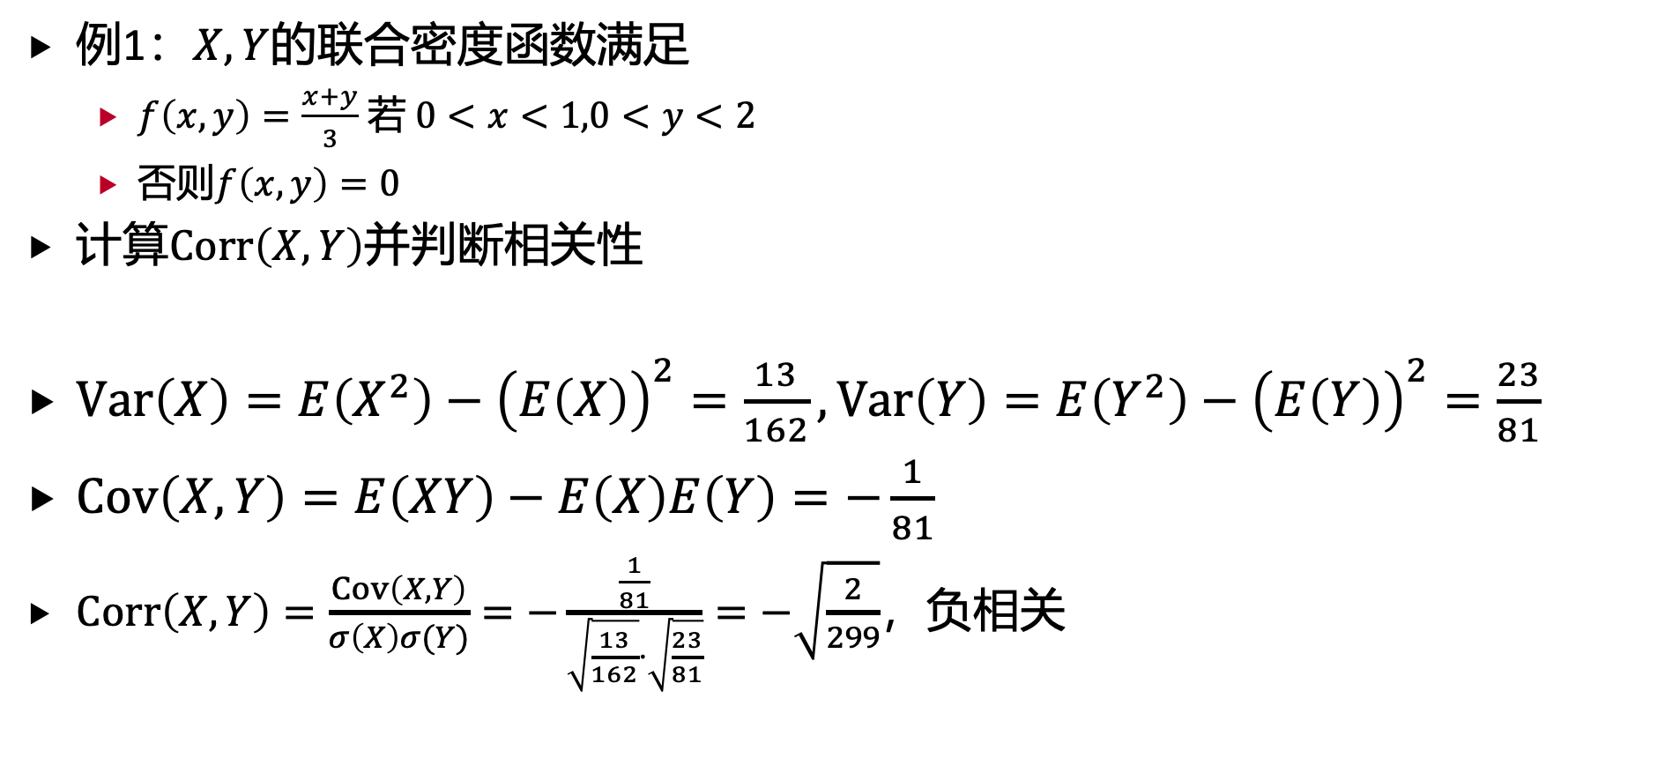
3. 多维连续随机变量的特征数
例1：$X,Y$的联合密度函数满足
$f\left(x,y\right)=\frac{x+y}{3}$ 若 $0<x<1,0<y<2$
否则$f\left(x,y\right)=0$
计算$Corr\left(X,Y\right)$并判断相关性
$Var\left(X\right)=E\left(X^{2}\right)−{\left(E\left(X\right)\right)}^{2}=\frac{13}{162},Var\left(Y\right)=E\left(Y^{2}\right)−{\left(E\left(Y\right)\right)}^{2}=\frac{23}{81}$
$Cov\left(X,Y\right)=E\left(XY\right)−E\left(X\right)E\left(Y\right)=−\frac{1}{81}$
$Corr\left(X,Y\right)=\frac{Cov\left(X,Y\right)}{σ\left(X\right)σ(Y)}=−\frac{\frac{1}{81}}{\sqrt{\frac{13}{162}}⋅\sqrt{\frac{23}{81}}}=−\sqrt{\frac{2}{299}}$，负相关

Slide 37
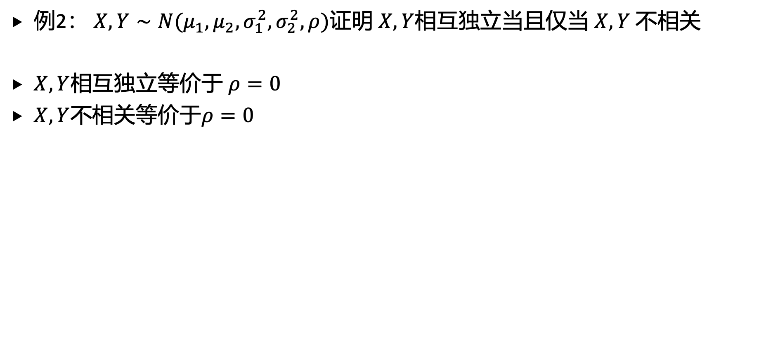
3. 多维连续随机变量的特征数
例2： $X,Y∼N(μ_{1},μ_{2},σ_{1}^{2},σ_{2}^{2},ρ)$证明 $X,Y$相互独立当且仅当 $X,Y$ 不相关
$X,Y$相互独立等价于 $ρ=0$
$X,Y$不相关等价于$ρ=0$

Slide 38
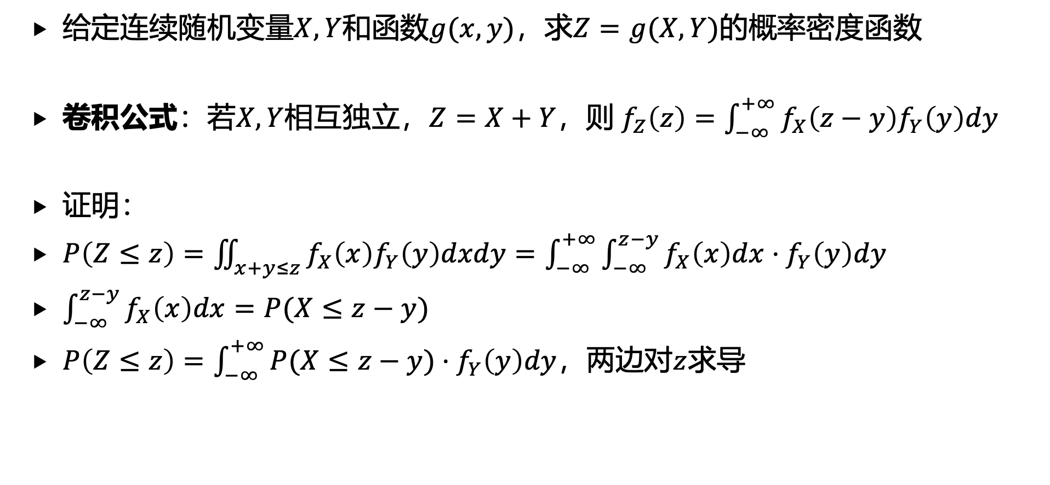
4. 多维连续随机变量函数的分布
给定连续随机变量$X,Y$和函数$g(x,y)$，求$Z=g(X,Y)$的概率密度函数
卷积公式：若$X,Y$相互独立，$Z=X+Y$，则${ f}_{Z}\left(z\right)=\int_{−∞}^{+∞}{f_{X}\left(z−y\right)f_{Y}\left(y\right)dy}$
证明：
$P\left(Z≤z\right)=\iint_{x+y≤z}{f_{X}\left(x\right)f_{Y}\left(y\right)dxdy}=\int_{−∞}^{+∞}{\int_{−∞}^{z−y}{f_{X}\left(x\right)dx}}⋅f_{Y}\left(y\right)dy$
$\int_{−∞}^{z−y}{f_{X}\left(x\right)dx}=P(X≤z−y)$
$P\left(Z≤z\right)=\int_{−∞}^{+∞}{P(X≤z−y)}⋅f_{Y}\left(y\right)dy$，两边对$z$求导

Slide 39
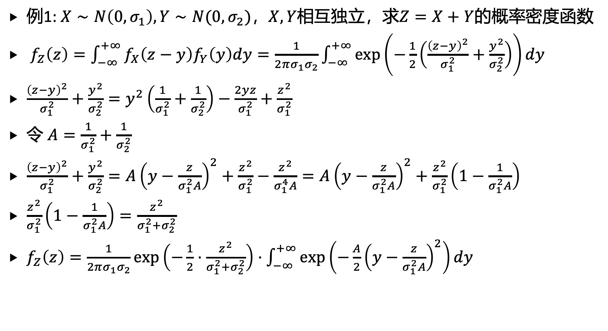
4. 多维连续随机变量函数的分布
例1: $X∼N\left(0,σ_{1}\right),Y∼N(0,σ_{2})$，$X,Y$相互独立，求$Z=X+Y$的概率密度函数
${ f}_{Z}\left(z\right)=\int_{−∞}^{+∞}{f_{X}\left(z−y\right)f_{Y}\left(y\right)dy}=\frac{1}{2πσ_{1}σ_{2}}\int_{−∞}^{+∞}{exp\left(−\frac{1}{2}\left(\frac{{\left(z−y\right)}^{2}}{σ_{1}^{2}}+\frac{y^{2}}{σ_{2}^{2}}\right)\right)}dy$
$\frac{{\left(z−y\right)}^{2}}{σ_{1}^{2}}+\frac{y^{2}}{σ_{2}^{2}}=y^{2}\left(\frac{1}{σ_{1}^{2}}+\frac{1}{σ_{2}^{2}}\right)−\frac{2yz}{σ_{1}^{2}}+\frac{z^{2}}{σ_{1}^{2}}$
令 $A=\frac{1}{σ_{1}^{2}}+\frac{1}{σ_{2}^{2}}$
$\frac{{\left(z−y\right)}^{2}}{σ_{1}^{2}}+\frac{y^{2}}{σ_{2}^{2}}=A{\left(y−\frac{z}{σ_{1}^{2}A}\right)}^{2}+\frac{z^{2}}{σ_{1}^{2}}−\frac{z^{2}}{σ_{1}^{4}A}=A{\left(y−\frac{z}{σ_{1}^{2}A}\right)}^{2}+\frac{z^{2}}{σ_{1}^{2}}\left(1−\frac{1}{σ_{1}^{2}A}\right)$
$\frac{z^{2}}{σ_{1}^{2}}\left(1−\frac{1}{σ_{1}^{2}A}\right)=\frac{z^{2}}{σ_{1}^{2}+σ_{2}^{2}}$
$f_{Z}\left(z\right)=\frac{1}{2πσ_{1}σ_{2}}exp\left(−\frac{1}{2}⋅\frac{z^{2}}{σ_{1}^{2}+σ_{2}^{2}}\right)⋅\int_{−∞}^{+∞}{exp\left(−\frac{A}{2}{\left(y−\frac{z}{σ_{1}^{2}A}\right)}^{2}\right)}dy$

Slide 40
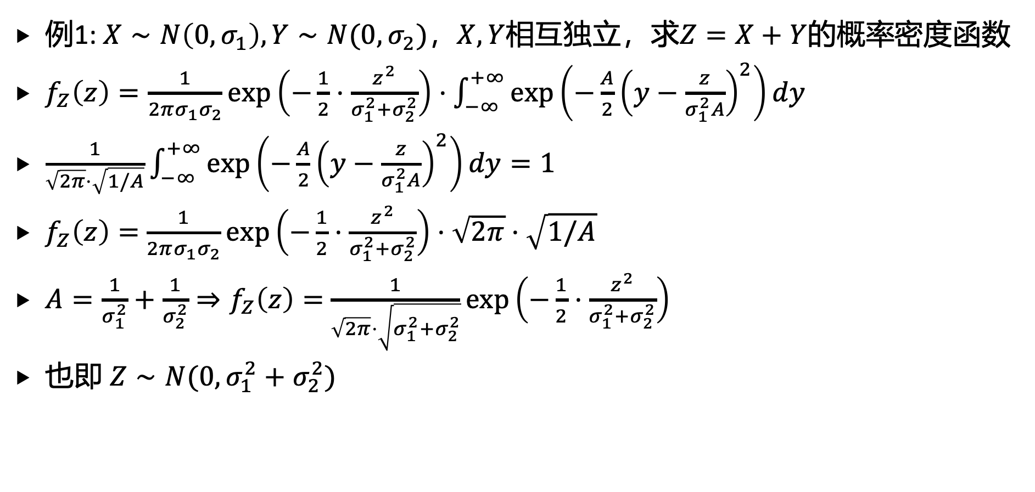
4. 多维连续随机变量函数的分布
例1: $X∼N\left(0,σ_{1}\right),Y∼N(0,σ_{2})$，$X,Y$相互独立，求$Z=X+Y$的概率密度函数
$f_{Z}\left(z\right)=\frac{1}{2πσ_{1}σ_{2}}exp\left(−\frac{1}{2}⋅\frac{z^{2}}{σ_{1}^{2}+σ_{2}^{2}}\right)⋅\int_{−∞}^{+∞}{exp\left(−\frac{A}{2}{\left(y−\frac{z}{σ_{1}^{2}A}\right)}^{2}\right)}dy$
$\frac{1}{\sqrt{2π}⋅\sqrt{1/A}}\int_{−∞}^{+∞}{exp\left(−\frac{A}{2}{\left(y−\frac{z}{σ_{1}^{2}A}\right)}^{2}\right)}dy=1$
$f_{Z}\left(z\right)=$ $\frac{1}{2πσ_{1}σ_{2}}exp\left(−\frac{1}{2}⋅\frac{z^{2}}{σ_{1}^{2}+σ_{2}^{2}}\right)⋅\sqrt{2π}⋅\sqrt{1/A}$
$A=\frac{1}{σ_{1}^{2}}+\frac{1}{σ_{2}^{2}}⇒f_{Z}\left(z\right)=$ $\frac{1}{\sqrt{2π}⋅\sqrt{σ_{1}^{2}+σ_{2}^{2}}}exp\left(−\frac{1}{2}⋅\frac{z^{2}}{σ_{1}^{2}+σ_{2}^{2}}\right)$
也即 $Z∼N(0,σ_{1}^{2}+σ_{2}^{2})$

Slide 41
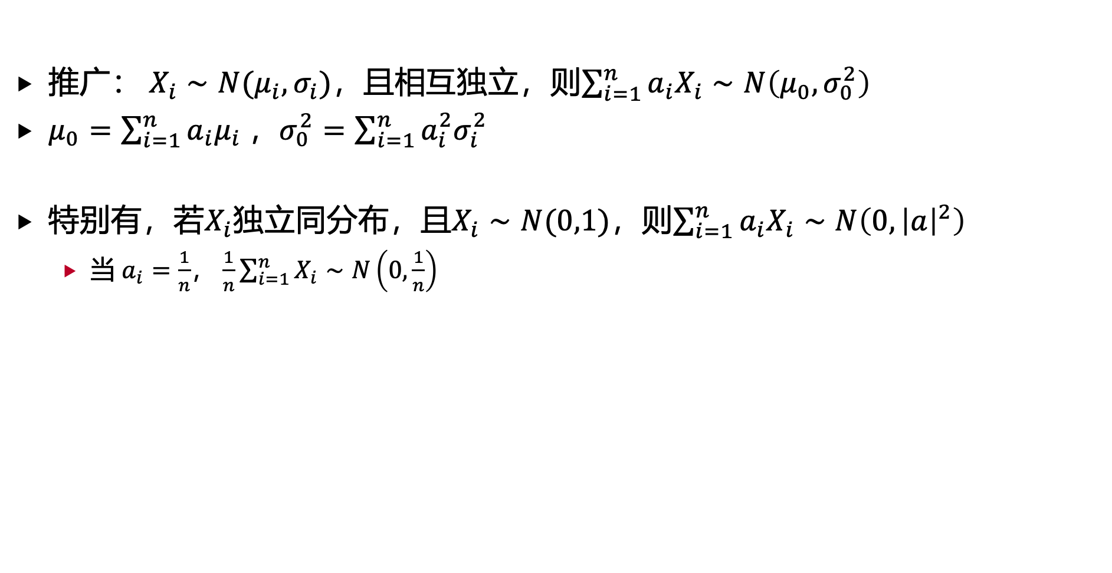
4. 多维连续随机变量函数的分布
推广： $X_{i}∼N(μ_{i},σ_{i})$，且相互独立，则$\sum_{i=1}^{n}{a_{i}X_{i}∼N\left(μ_{0},σ_{0}^{2}\right)}$
$μ_{0}=\sum_{i=1}^{n}{a_{i}μ_{i} }$，$σ_{0}^{2}=\sum_{i=1}^{n}{a_{i}^{2}σ_{i}^{2}}$
特别有，若$X_{i}$独立同分布，且$X_{i}∼N(0,1)$，则$\sum_{i=1}^{n}{a_{i}X_{i}∼N\left(0,{\left|a\right|}^{2}\right)}$
当 $a_{i}=\frac{1}{n}$， $\frac{1}{n}\sum_{i=1}^{n}{X_{i}}∼N\left(0,\frac{1}{n}\right)$

Slide 42
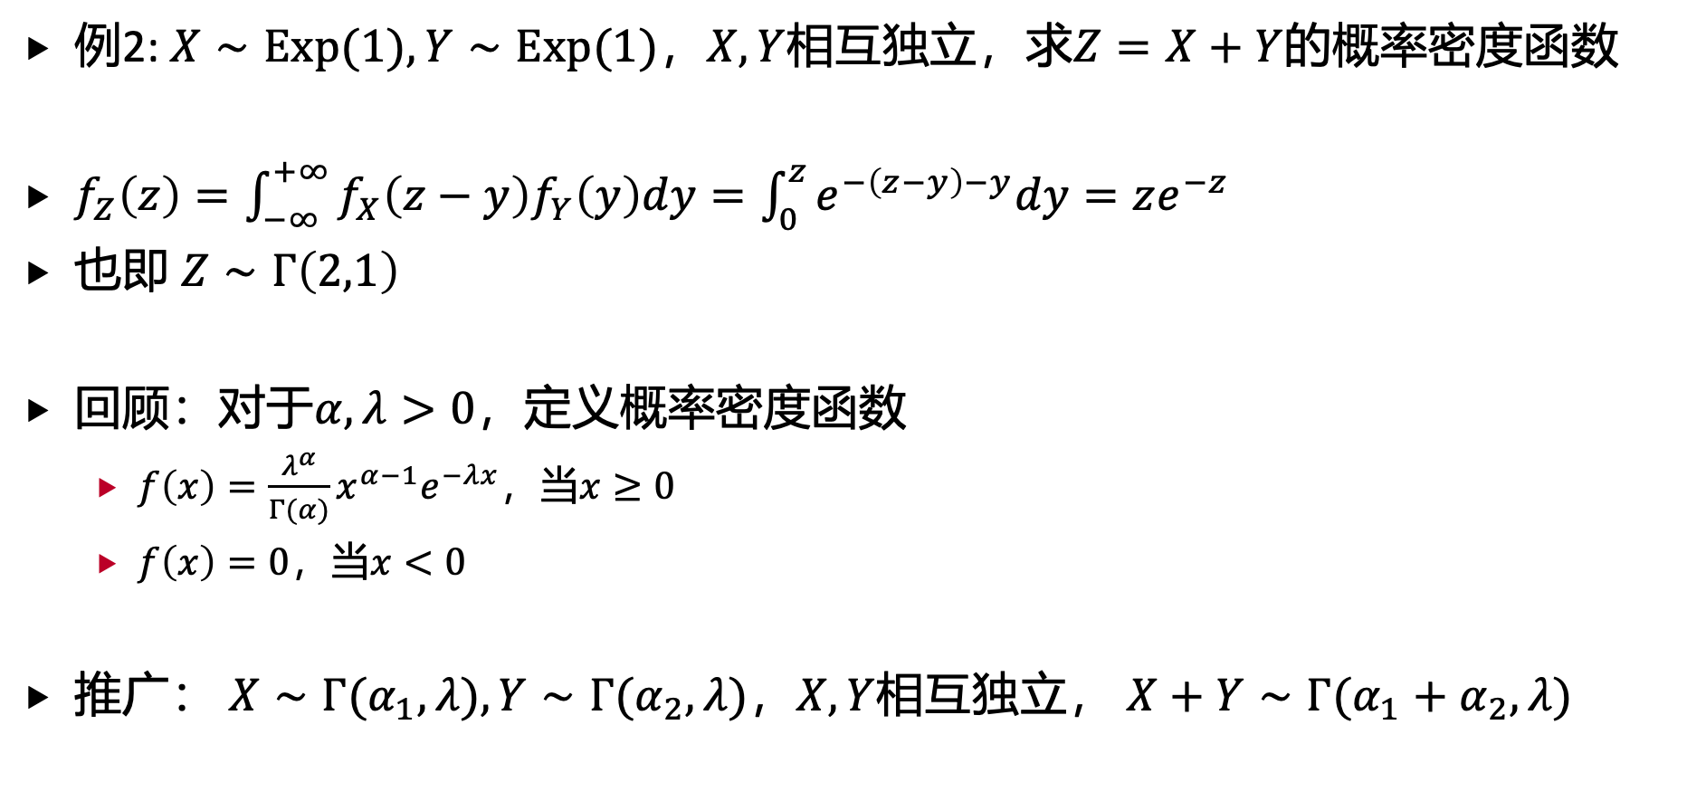
4. 多维连续随机变量函数的分布
例2: $X∼Exp(1),Y∼Exp(1)$，$X,Y$相互独立，求$Z=X+Y$的概率密度函数
$f_{Z}\left(z\right)=\int_{−∞}^{+∞}{f_{X}\left(z−y\right)f_{Y}\left(y\right)dy}=\int_{0}^{z}{e^{−\left(z−y\right)−y}dy}=ze^{−z}$
也即 $Z∼Γ\left(2,1\right)$
回顾：对于$α,λ>0$，定义概率密度函数
$f\left(x\right)=\frac{λ^{α}}{Γ(α)}x^{α−1}e^{−λx}$，当$x≥0$
$f\left(x\right)=0$，当$x<0$
推广： $X∼Γ(α_{1},λ),Y∼Γ(α_{2},λ)$，$X,Y$相互独立， $X+Y∼Γ(α_{1}+α_{2},λ)$

Slide 43
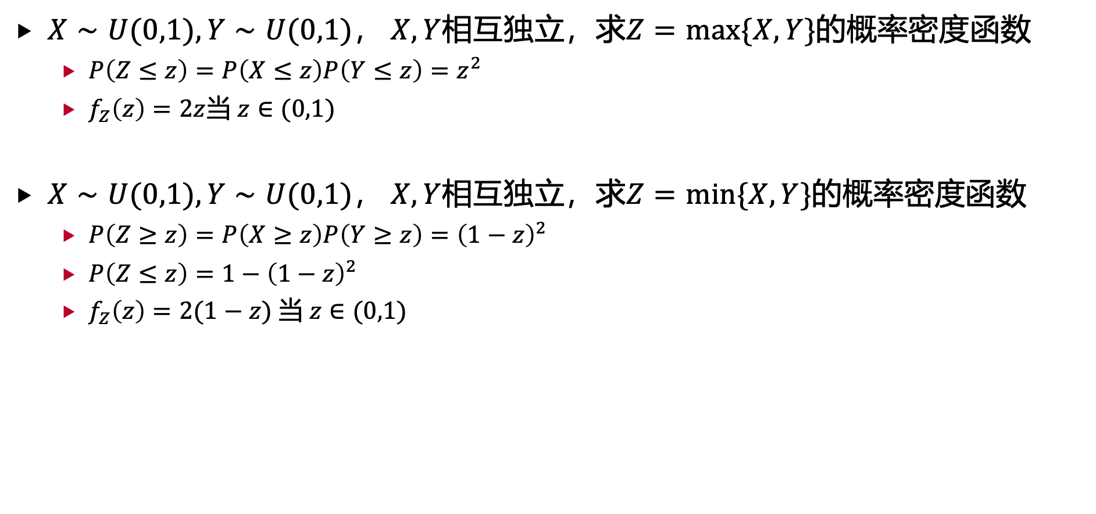
4. 多维连续随机变量函数的分布
$X∼U(0,1),Y∼U(0,1)$， $X,Y$相互独立，求$Z=max\{X,Y\}$的概率密度函数
$P\left(Z≤z\right)=P\left(X≤z\right)P\left(Y≤z\right)=z^{2}$
$f_{Z}\left(z\right)=2z$当 $z∈(0,1)$
$X∼U(0,1),Y∼U(0,1)$， $X,Y$相互独立，求$Z=min\{X,Y\}$的概率密度函数
$P\left(Z≥z\right)=P\left(X≥z\right)P\left(Y≥z\right)={\left(1−z\right)}^{2}$
$P\left(Z≤z\right)=1−{\left(1−z\right)}^{2}$
$f_{Z}\left(z\right)=2(1−z)$ 当 $z∈(0,1)$

Slide 44
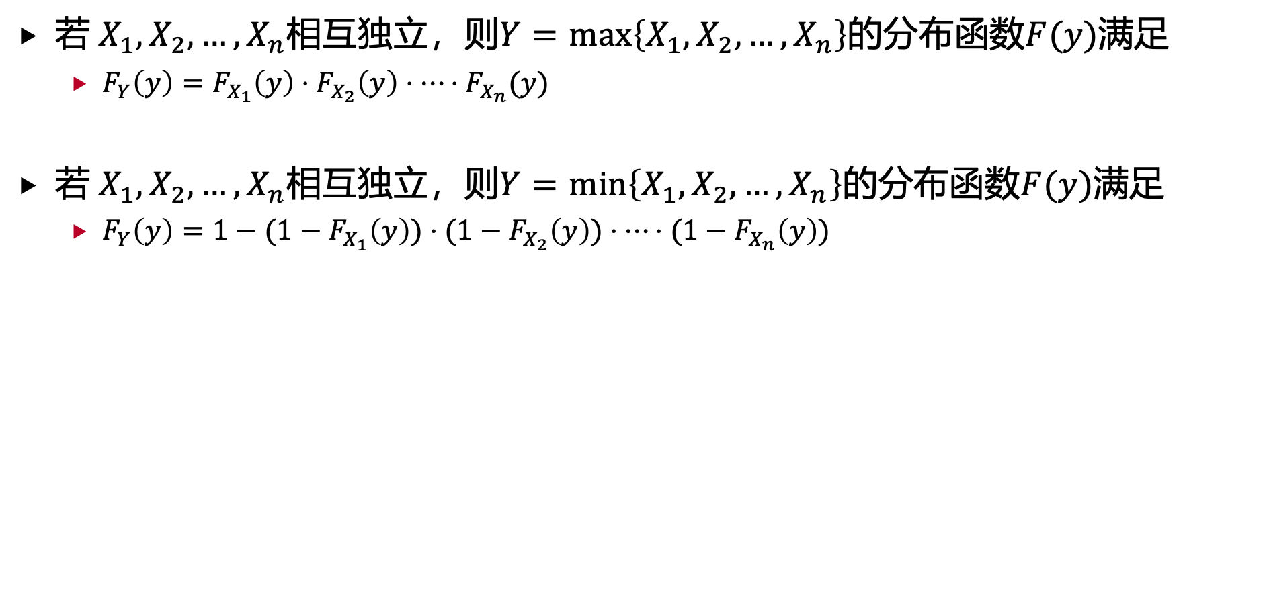
4. 多维连续随机变量函数的分布
若 $X_{1},X_{2},…,X_{n}$相互独立，则$Y=max\left\{X_{1},X_{2},…, X_{n}\right\}$的分布函数$F(y)$满足
$F_{Y}\left(y\right)=F_{X_{1}}\left(y\right)⋅F_{X_{2}}\left(y\right)⋅⋯⋅F_{X_{n}}(y)$
若 $X_{1},X_{2},…,X_{n}$相互独立，则$Y=min\left\{X_{1},X_{2},…, X_{n}\right\}$的分布函数$F(y)$满足
$F_{Y}\left(y\right)=1−(1−F_{X_{1}}\left(y\right))⋅(1−F_{X_{2}}\left(y\right))⋅⋯⋅(1−F_{X_{n}}\left(y\right))$

Slide 45
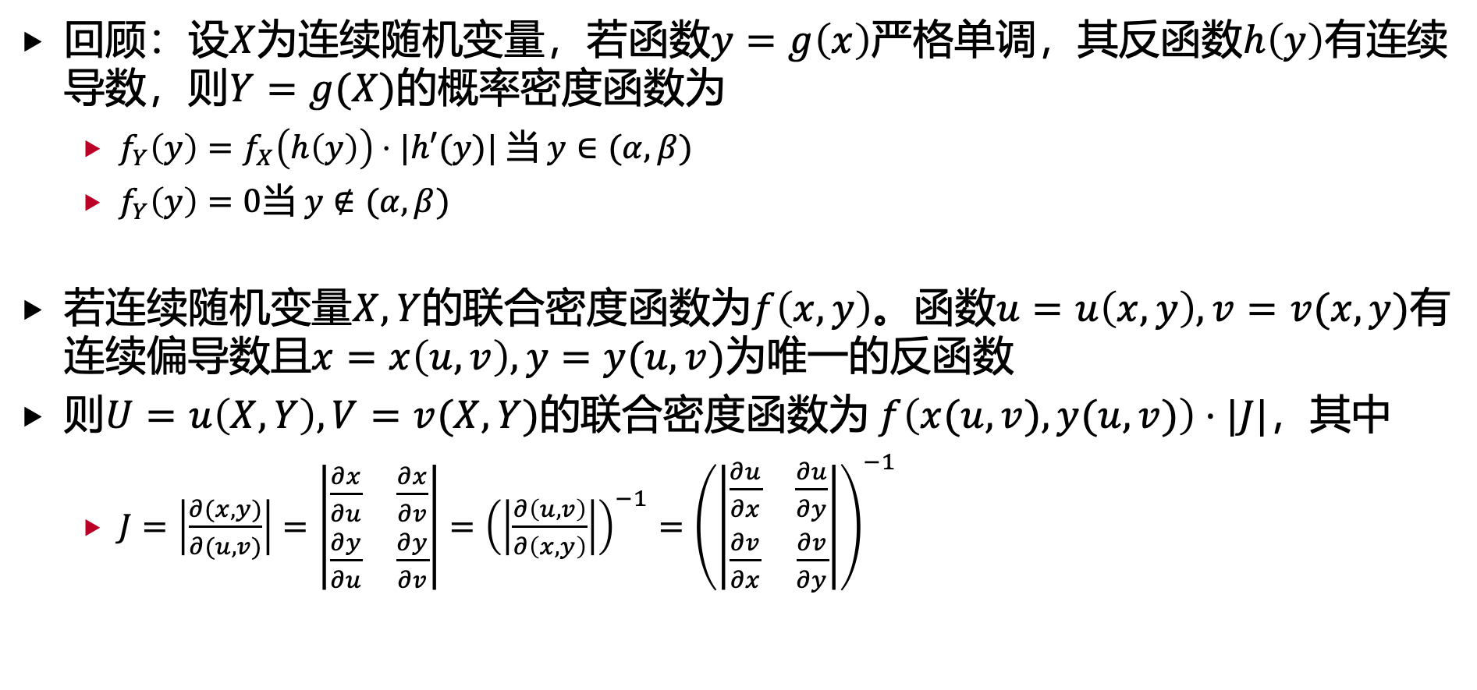
4. 多维连续随机变量函数的分布
回顾：设$X$为连续随机变量，若函数$y=g\left(x\right)$严格单调，其反函数$h\left(y\right)$有连续导数，则$Y=g(X)$的概率密度函数为
$f_{Y}\left(y\right)=f_{X}\left(h\left(y\right)\right)⋅|h′(y)|$ 当 $y∈(α,β)$
$f_{Y}\left(y\right)=0$当 $y∉(α,β)$
若连续随机变量$X,Y$的联合密度函数为$f\left(x,y\right)$。函数$u=u\left(x,y\right),v=v(x,y)$有连续偏导数且$x=x\left(u,v\right),y=y(u,v)$为唯一的反函数
则$U=u\left(X,Y\right),V=v(X,Y)$的联合密度函数为 $f\left(x(u, v),y(u,v)\right)⋅|J|$，其中
$J=\left|\frac{∂(x,y)}{∂(u,v)}\right|=\left|\begin{matrix}\frac{∂x}{∂u} & \frac{∂x}{∂v} \\ \frac{∂y}{∂u} & \frac{∂y}{∂v}\end{matrix}\right|={\left(\left|\frac{∂\left(u,v\right)}{∂\left(x,y\right)}\right|\right)}^{−1}={\left(\left|\begin{matrix}\frac{∂u}{∂x} & \frac{∂u}{∂y} \\ \frac{∂v}{∂x} & \frac{∂v}{∂y}\end{matrix}\right|\right)}^{−1}$

Slide 46
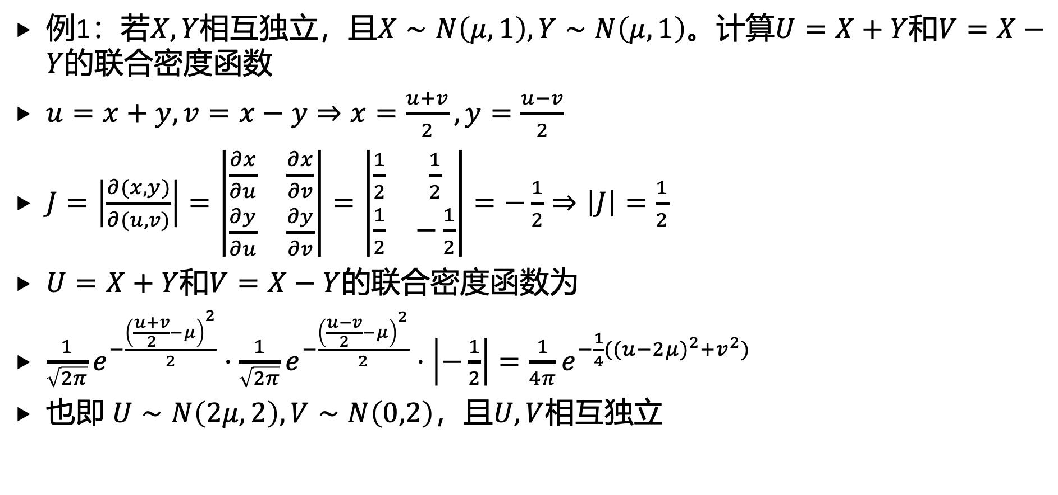
4. 多维连续随机变量函数的分布
例1：若$X,Y$相互独立，且$X∼N\left(μ,1\right),Y∼N\left(μ,1\right)$。计算$U=X+Y$和$V=X−Y$的联合密度函数
$u=x+y,v=x−y⇒x=\frac{u+v}{2},y=\frac{u−v}{2}$
$J=\left|\frac{∂(x,y)}{∂(u,v)}\right|=\left|\begin{matrix}\frac{∂x}{∂u} & \frac{∂x}{∂v} \\ \frac{∂y}{∂u} & \frac{∂y}{∂v}\end{matrix}\right|=\left|\begin{matrix}\frac{1}{2} & \frac{1}{2} \\ \frac{1}{2} & −\frac{1}{2}\end{matrix}\right|=−\frac{1}{2}⇒\left|J\right|=\frac{1}{2}$
$U=X+Y$和$V=X−Y$的联合密度函数为
$\frac{1}{\sqrt{2π}}e^{−\frac{{\left(\frac{u+v}{2}−μ\right)}^{2}}{2}}⋅\frac{1}{\sqrt{2π}}e^{−\frac{{\left(\frac{u−v}{2}−μ\right)}^{2}}{2}}⋅\left|−\frac{1}{2}\right|=\frac{1}{4π}e^{−\frac{1}{4}({(u−2μ)}^{2}+v^{2})}$
也即 $U∼N\left(2μ,2\right),V∼N\left(0,2\right)$，且$U,V$相互独立

Slide 47
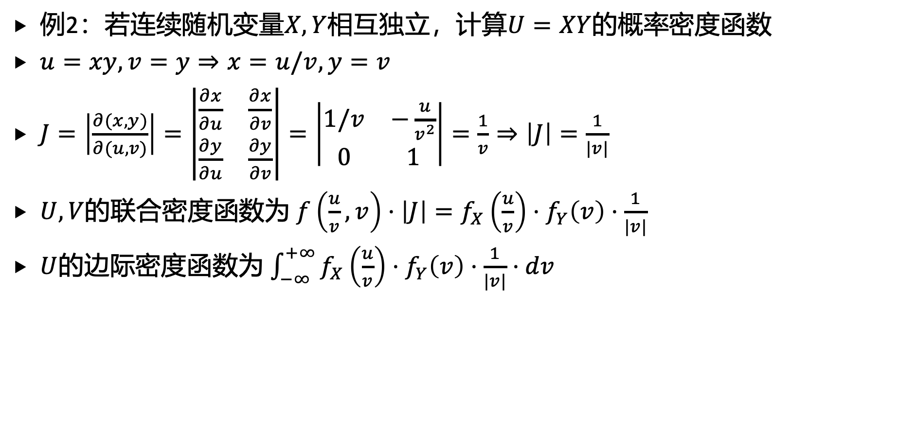
4. 多维连续随机变量函数的分布
例2：若连续随机变量$X,Y$相互独立，计算$U=XY$的概率密度函数
$u=xy,v=y⇒x=u/v,y=v$
$J=\left|\frac{∂(x,y)}{∂(u,v)}\right|=\left|\begin{matrix}\frac{∂x}{∂u} & \frac{∂x}{∂v} \\ \frac{∂y}{∂u} & \frac{∂y}{∂v}\end{matrix}\right|=\left|\begin{matrix}1/v & −\frac{u}{v^{2}} \\ 0 & 1\end{matrix}\right|=\frac{1}{v}⇒\left|J\right|=\frac{1}{|v|}$
$U,V$的联合密度函数为 $f\left(\frac{u}{v},v\right)⋅\left|J\right|=f_{X}\left(\frac{u}{v}\right)⋅f_{Y}\left(v\right)⋅\frac{1}{|v|}$
$U$的边际密度函数为 $\int_{−∞}^{+∞}{f_{X}\left(\frac{u}{v}\right)⋅f_{Y}\left(v\right)⋅\frac{1}{|v|}⋅dv}$

Slide 48
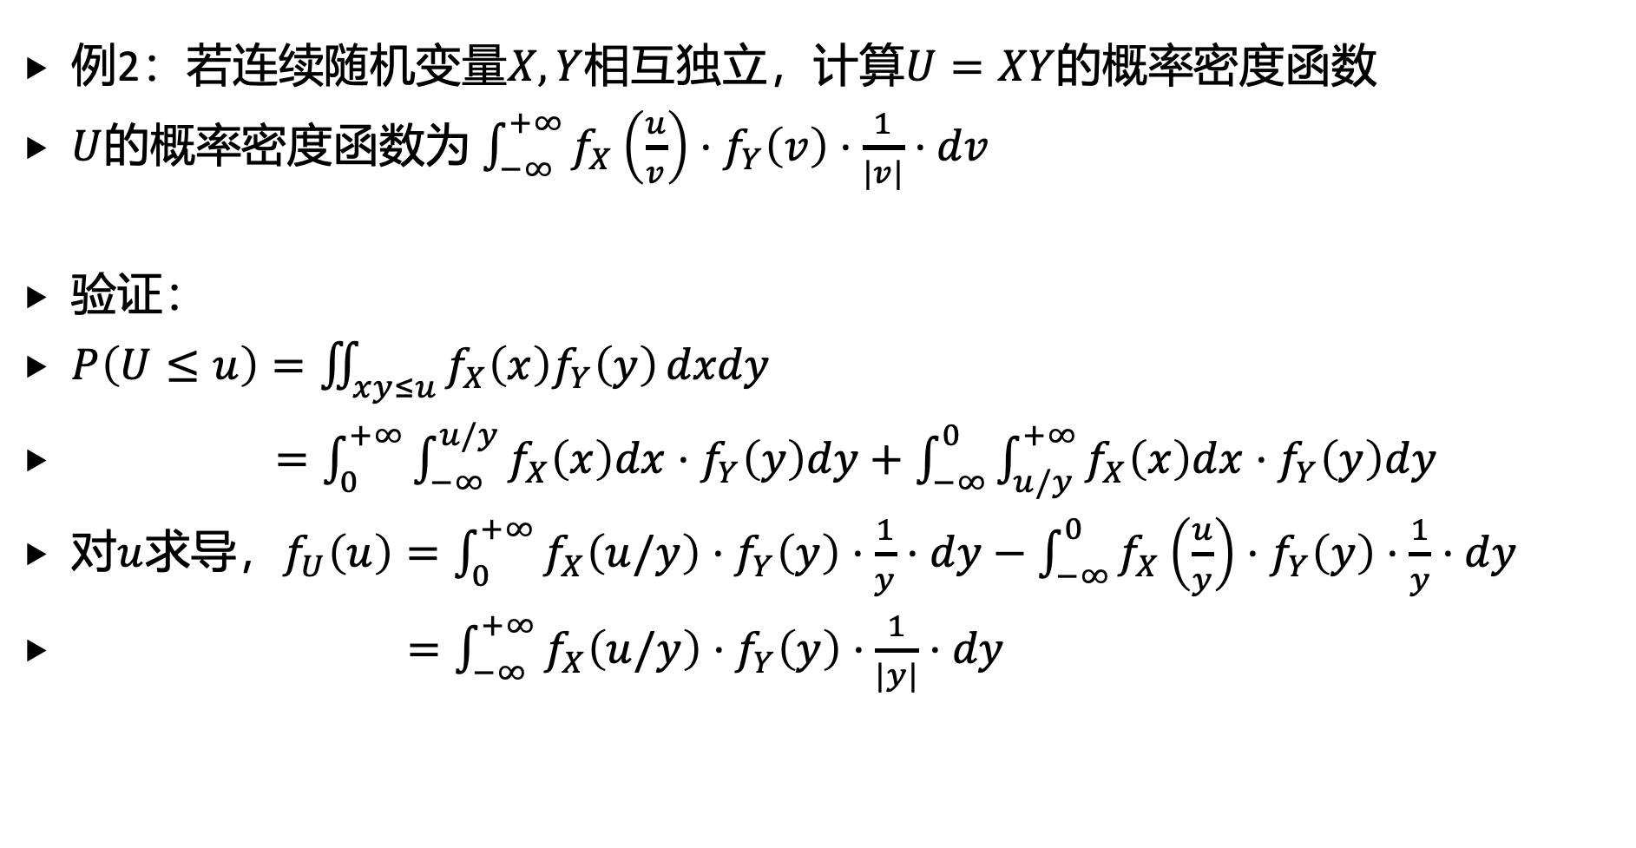
4. 多维连续随机变量函数的分布
例2：若连续随机变量$X,Y$相互独立，计算$U=XY$的概率密度函数
$U$的概率密度函数为 $\int_{−∞}^{+∞}{f_{X}\left(\frac{u}{v}\right)⋅f_{Y}\left(v\right)⋅\frac{1}{|v|}⋅dv}$
验证：
$P\left(U≤u\right)=\iint_{xy≤u}{f_{X}\left(x\right)f_{Y}\left(y\right)}dxdy$
$=\int_{0}^{+∞}{\int_{−∞}^{u/y}{f_{X}\left(x\right)dx}}⋅f_{Y}\left(y\right)dy+\int_{−∞}^{0}{\int_{u/y}^{+∞}{f_{X}\left(x\right)dx}}⋅f_{Y}\left(y\right)dy$
对$u$求导，$f_{U}\left(u\right)=\int_{0}^{+∞}{f_{X}\left(u/y\right)}⋅f_{Y}\left(y\right)⋅\frac{1}{y}⋅dy−\int_{−∞}^{0}{f_{X}\left(\frac{u}{y}\right)}⋅f_{Y}\left(y\right)⋅\frac{1}{y}⋅dy$
$=\int_{−∞}^{+∞}{f_{X}\left(u/y\right)}⋅f_{Y}\left(y\right)⋅\frac{1}{|y|}⋅dy$

Slide 49
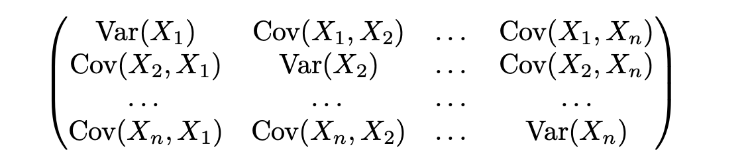
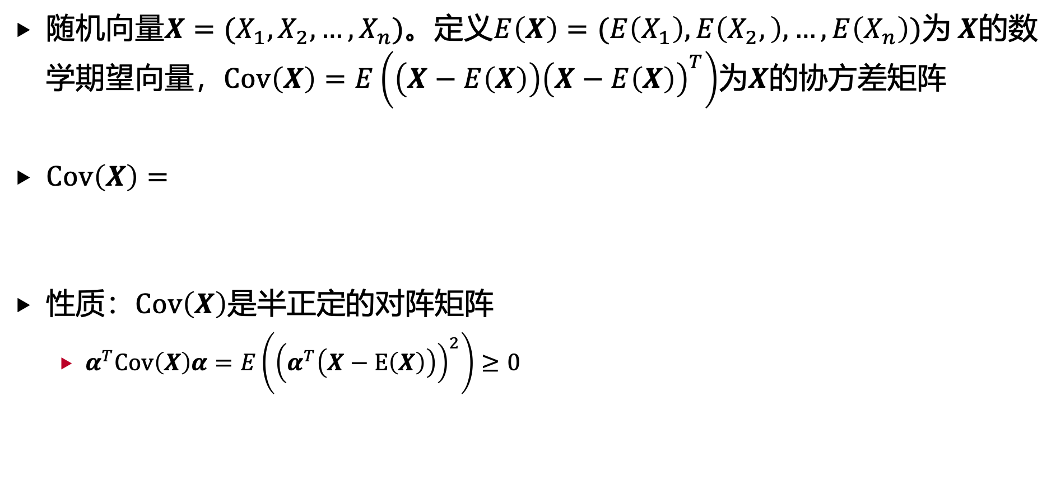
5. 多维高斯分布
随机向量$X=(X_{1},X_{2},…, X_{n})$。定义$E\left(X\right)=(E\left(X_{1}\right), E\left(X_{2},\right),…, E\left(X_{n}\right))$为 $X$的数学期望向量，$Cov\left(X\right)=E\left(\left(X−E\left(X\right)\right){\left(X−E\left(X\right)\right)}^{T}\right)$为$X$的协方差矩阵
$Cov\left(X\right)=$
性质：$Cov\left(X\right)$是半正定的对阵矩阵
$α^{T}Cov\left(X\right)α=E\left({\left(α^{T}\left(X−E\left(X\right)\right)\right)}^{2}\right)≥0$

Slide 50
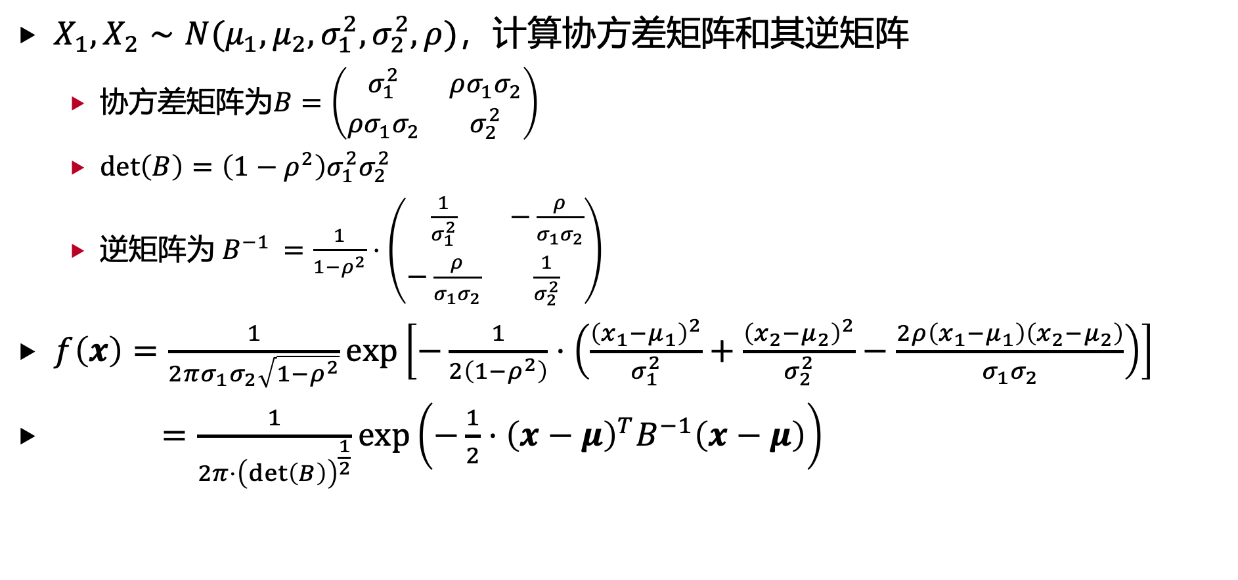
5. 多维高斯分布
$X_{1},X_{2}∼N(μ_{1},μ_{2},σ_{1}^{2},σ_{2}^{2},ρ)$，计算协方差矩阵和其逆矩阵
协方差矩阵为$B=\left(\begin{matrix}σ_{1}^{2} & ρσ_{1}σ_{2} \\ ρσ_{1}σ_{2} & σ_{2}^{2}\end{matrix}\right)$
$det\left(B\right)=\left(1−ρ^{2}\right)σ_{1}^{2}σ_{2}^{2}$
逆矩阵为 $B^{−1 }=\frac{1}{1−ρ^{2}}⋅\left(\begin{matrix}\frac{1}{σ_{1}^{2}} & −\frac{ρ}{σ_{1}σ_{2}} \\ −\frac{ρ}{σ_{1}σ_{2}} & \frac{1}{σ_{2}^{2}}\end{matrix}\right)$
$f\left(x\right)=\frac{1}{2πσ_{1}σ_{2}\sqrt{1−ρ^{2}}}exp\left[−\frac{1}{2\left(1−ρ^{2}\right)}⋅\left(\frac{{\left(x_{1}−μ_{1}\right)}^{2}}{σ_{1}^{2}}+\frac{{\left(x_{2}−μ_{2}\right)}^{2}}{σ_{2}^{2}}−\frac{2ρ\left(x_{1}−μ_{1}\right)\left(x_{2}−μ_{2}\right)}{σ_{1}σ_{2}}\right)\right]$
$=\frac{1}{2π⋅{\left(det\left(B\right)\right)}^{\frac{1}{2}}}exp\left(−\frac{1}{2}⋅{\left(x−μ\right)}^{T}B^{−1}\left(x−μ\right)\right)$

Slide 51

5. 多维高斯分布
$n$维高斯分布的联合密度函数为
$f\left(x\right)=\frac{1}{{\left(2π\right)}^{\frac{n}{2}}⋅{\left(det\left(B\right)\right)}^{\frac{1}{2}}}exp\left(−\frac{1}{2}⋅{\left(x−μ\right)}^{T}B^{−1}\left(x−μ\right)\right)$
数学期望向量：$μ∈ℝ^{n}$
协方差矩阵：$B∈ℝ^{n×n}$
记号： $X∼N(μ,B)$
当 $μ=0$， $B=I_{n}$，
$f\left(x\right)={\left(2π\right)}^{−\frac{n}{2}}⋅exp\left(−\frac{1}{2}{\left|x−μ\right|}^{2}\right)=\prod_{i=1}^{n}{\frac{1}{\sqrt{2π}}⋅\exp\left(−\frac{{\left(x_{i}−μ_{i}\right)}^{2}}{2}\right)}$
也即 $X_{1},X_{2},…, X_{n}$相互独立且 $X_{i}∼N(0,1)$

Slide 52

5. 多维高斯分布
$n$维高斯分布的联合密度函数为
$f\left(x\right)=\frac{1}{{\left(2π\right)}^{\frac{n}{2}}⋅{\left(det\left(B\right)\right)}^{\frac{1}{2}}}exp\left(−\frac{1}{2}⋅{\left(x−μ\right)}^{T}B^{−1}\left(x−μ\right)\right)$
性质：
边际分布 $X_{i}∼N(μ_{i},B_{i,i})$
$X_{1},X_{2},…, X_{n}$相互独立等价于 $X_{1},X_{2},…, X_{n}$两两不相关，也即$B$为对角矩阵
$X∼N\left(μ,B\right)⇒AX+b∼N\left(Aμ+b,ABA^{T}\right)$
$X∼N(0,I_{n})$，$U$为正交矩阵，则$UX∼N(0,I_{n})$
$X∼N\left(μ,B\right)⇒B^{−\frac{1}{2}}\left(X−μ\right)∼N(0,I_{n})$

Slide 53

5. 多维高斯分布
$n$维高斯分布的联合密度函数为
$f\left(x\right)=\frac{1}{{\left(2π\right)}^{\frac{n}{2}}⋅{\left(det\left(B\right)\right)}^{\frac{1}{2}}}exp\left(−\frac{1}{2}⋅{\left(x−μ\right)}^{T}B^{−1}\left(x−μ\right)\right)$
$X∼N\left(μ,B\right)$，令$Y=AX+b$
$f_{Y}\left(y\right)=f_{X}\left(A^{−1}(y−b)\right)⋅\left|\frac{∂x}{∂y}\right|=f_{X}\left(A^{−1}\left(y−b\right)\right)⋅{\left|\frac{∂y}{∂x}\right|}^{−1}=f_{X}\left(A^{−1}(y−b\right))\frac{1}{|det\left(A\right)|}$
$=\frac{1}{{\left(2π\right)}^{\frac{n}{2}}⋅{\left(det\left(B\right)\right)}^{\frac{1}{2}}}exp\left(−\frac{1}{2}⋅{\left(A^{−1}\left(y−b\right)−μ\right)}^{T}B^{−1}\left(A^{−1}(y−b\right)−μ)\right)⋅\frac{1}{|det\left(A\right)|}$
$=\frac{1}{{\left(2π\right)}^{\frac{n}{2}}⋅{\left(det\left(ABA^{T}\right)\right)}^{\frac{1}{2}}}exp\left(−\frac{1}{2}⋅{{\left(y−Aμ−b\right)}^{T}\left(ABA^{T}\right)}^{−1 }\left(y−Aμ−b\right)\right)$

